Slide 1
Department of Information Technology
Welcomes Honorable NBA Committee
12th February 2016

Slide 2
Presentation on Department Overview and UG Programme
12th February 2016
Department of Information Technology

Slide 3
Contents
Programme Educational Objectives, participation of Constituents, Level of implementation
Overview of Course Content delivery, course outcome assessment and evaluation methods
Overview of Assessment and evaluation of Program Outcomes
Curriculum Design and Revision, and Program Specific Criteria
Academic Performance of students, participation in professional activities and their achievements
Faculty development and research activity

Slide 4
Department Profile
Information Technology
UG Course

Slide 5

Department Highlights
Irrespective of Market trends & Condition, the department is able to attract students and fill up all the seats.
Consistent result above 90% with success rate 84%.
Consistent placement record , and is above75% out of eligible students.
Three toppers and one rank holder since 2005
100 % faculty is PG., 04 PhD, 06 PhD Pursuing
48% faculty have experience higher than 5 years in TCET & 52% faculty have more than 5 years as a whole.
Ranked high in 3i survey conducted by AICTE-CII in AY 2013-2014 and 14-15.

Slide 6
Department Growth
Started in 2001
With Intake 60 , this Intake was increased to 120 in 2003
2005
RvA Accreditation under ISO 9000:2000 Certification
2010
ICWET 1st International Conference with ACM
Started Students ACM Chapter
Upgraded ISO to 9001:2008 Standard
2011
NBA Accreditation for 3 Years
PG Programs Started with 18 intake
Started R&D Cell
2013
AICTE MODROBS Grant for VCC Lab
TCET Accenture Innovation Center Started
Graded High by AICTE-CII 3i Survey
Started EDC Cell
2016
IEDC Grant of 7th International Conference ICCCV in Association with Elsevier. IMC RBNQA AWARD in Education Sector
2015
University of Mumbai Permanent Affiliation Expert Committee Visit
Started HOC Cell
Started Incubation Center
NEN Best Debut Award at National Level

Slide 7
Mission Vision Statement: Institute and Department
Institute Vision: Thakur College of Engineering and Technology will excel in Technical Education to become an internationally renowned premier Institute of Engineering and Technology. | Institute Mission: To provide state of the art infrastructure and right academic ambience for developing professional skills as well as an environment for growth of leadership and managerial skills to students which will make them competent engineers to deliver quality results in industry.
Department Vision: The Department of IT will strive to be at the top position among the renowned providers of IT education. | Department Mission: The IT Department is committed to enrich students by rigorously implementing quality education with a focus to make them industry ready, while imbibing in them professional ethics and social values to become responsible citizens.

Slide 8
Goals
Short Term Goals (1-3 Years)
All students at third year level should achieve 60% (6.5 CGPA) aggregate to be eligible for placement
Long Term Goals ( > 3 Years)
At least 30% of students in third year level to appear for GATE/ GRE , TOEFL and Professional Certifications through HOC Cell.
To sustain results as per TCET Quality objective for SE,TE,BE.
At least one tie-up per annum with renowned industries such as Infosys, Persistent, Accenture etc. during conference, workshop for their overall growth (3i).
Take steps for Bridging gap in curriculum, by designing minimum one bridge course per semester.
Conduct Organized research work in view of at least one Patent/ IPR development per year.
Start student exchange, collaborative research program with Foreign Universities of repute.
To have Ph.D. research programs in field of Information Technology.
Increase Industry collaboration for setting up center of excellence on campus.
Setup IT Education Hub for skill development at various levels.

Slide 9
Department at a Glance
IT Department
Infrastructure
Faculty
Students
6 Classrooms
8 Labs
Staffroom, HOD Cabin, Counseling Room
Department Library, Discussion Room
30 Faculty Members
4 PhD, 6 PhD Pursuing, 17 PG
9 Support Staff
Sanction Intake 120
SE, TE, BE
Total 480
24 Students Direct Second Year

Slide 10
Programme Educational Objectives (PEOs)
Participation of Constituents, Level of implementation

Slide 11
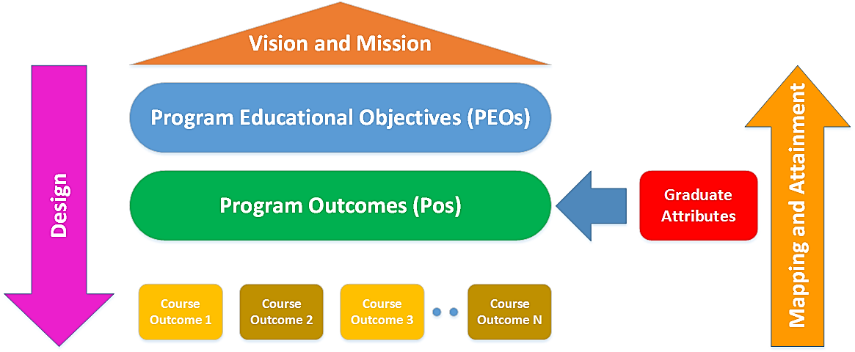
MVS, PEO, PO, GA and CO Relation

Slide 12
PEO
Successful career
Communication skills for professional growth
Independent & Critical thinking and problem solving
Best Practices & Technologies
Fundamental Knowledge of IT Courses
R&D and EDC Skills
Programming Tools
PEO

Slide 13
PEO Revision
2001
Establishment of Institute with the PEO (Quality Objectives) of creating competent engineering Graduates
2005
ISO: 9001:2000
implemented with PEO of Quality Engineering Graduates. PEOs set through Quality Objectives
2009
ISO: 9001:2008 (Emphasis on design & development)
5 PEOs defined as per NBA SAR.
2013
ISO: 9001:2008
Formalization of PEOs (reference from PEOs of UoM, NBA Graduate Attributes) & alignment with quality objectives. And based on stakeholders feedback.

Slide 14
Programme Education Objectives (PEOs) –2013 Onwards
1. To enable learners to gain a broad background across fundamental areas of information technology along with a depth of understanding in a particular area of interest within the domain of information systems.
2. To prepare learners for effectively using modern programming tools to solve real life problems.
3. To prepare learners for successful career in Indian and Multinational Organizations. To Identify and evaluate current and emerging technologies. To assess their applicability to address the users’ needs and recognize the need for continued learning. To motivate students to pursue it throughout their career and higher studies.
4. To encourage and motivate learners for research & development and entrepreneurship.
5. To inculcate independent, critical thinking, problem solving and leadership skills, and develop an ability to analyze the impact of technology on individuals, organizations and society including professional, ethical, legal and public policy issues.
6. To encourage learners to use best practices and implement technologies to enhance information security and enable compliance to set guidelines, ensuring confidentiality, information integrity, and availability.
7. To develop excellent written and oral communication skills to effectively interact with clients, users, co-workers and managers. To collaborate and work in teams to accomplish a common goal by integrating personal initiative and group cooperation.

Slide 15
PEOs- Implementation
Achieved by
PEO1
Deals
with
University Curriculum
Foundation for basic engineering
Attained
by
CO
VISSION
MISSION
Programming Tools
Independent & Critical thinking and problem solving
Best Practices & Technologies
Implemented
through
PEO2
PEO 5
PEO 6
University curriculum of Second to Final Year
CO
PEO 4
R&D , EDC Cell, Incubation Centre
R&D and EDC
PO

Slide 16
PEOs – Implementation
Best Practices, Information Security, Integrity, Professional Compliance
PEO 6
Deals
with
Campus Connect, Professional Body, Bridge courses & Co and Extra curricular
activities
Achieved by
Attained through
PEO 7
Communication skills for professional growth
, Teamwork, Professional Growth, Successful Career
Deals
with
VISSION
MISSION
Implemented
through
Higher Education and Online Certification Cell (HOC)
Achieved by
Higher Studies, successful career in Indian and Multinational Organizations
PEO 3
Deals
with
Attained through
PO

Slide 17
Academic Factors Contributing to the PEOs
Sr. No. | Academic Factor | Description
1 | University Curriculum | Department Conducts the Curriculum of UoM leading to the award of four years degree course in IT engineering. The Curriculum prescribed by university has 58 courses equivalent to 219 credits.
2 | Industry Oriented Campus Connect Programs | Major placement opportunities are available with the IT Sector. Therefore the institute promotes the opportunity to the students for multidisciplinary learning through industry oriented campus connect program.
3 | Bridge Courses | To fill-up the gap existing between curriculum and the industry requirements. The courses are conducted either during the semester or the semester break.
4 | Projects | During the programme duration the students are mainly doing five projects, four projects as a part of curriculum and one as a part of IOCC programme.

Slide 18
Curriculum Component Curriculum Content Mapping with the PEOs
Academic factors | Course Component (R 2012) | PEOs | Curriculum Content (% of total number of credits of the program ) | Range of Total Credits (AICTE) %
 |  |  |  | Minimum | Maximum
University curriculum | Mathematics and Basic Sciences | 1,4,5,6 | 17.14 | 15 | 20
 | Basic Engineering courses | 1,4,5 | 9.52 | 15 | 20
 | Humanities & Social Sciences | 3,5,7 | 2.38 | 05 | 10
 | Professional core | 1,2, 3,5, 6,7 | 66.19 | 30 | 40
 | Electives | 2, 3,5,6,7 | 4.76 | 10 | 15

Slide 19
Curriculum Mapping with the PEOs
Course Component | % of total number of credits of the program | PEOs
 |  | 1 | 2 | 3 | 4 | 5 | 6 | 7
Mathematics and Basic Sciences | 17.14 | √ | - | √ | - | - | - | -
Basic Engineering courses | 9.52 | √ | √ | √ | - | - | - | -
Humanities & Social Sciences | 2.38 | √ | √ | - | - | √ | - | √
Professional core | 66.19 | - | √ | √ | √ | √ | √ | -
Electives | 4.76 | - | - | - | √ | - | - | √
% Contribution of the Courses to the PEOs |  | 34.8 | 81.4 | 91.8 | 65.2 | 64.0 | 60.50 | 8.20

Slide 20
Campus Connect training programme and Bridge Courses
IOCC and Bridge Course mapping with the PEOs,
total number of hours, credits, Curriculum content
Campus Connect training programme and bridge courses mapping to PEO
Sr. No. | Supportive factor | Course Components | PEOs | Total Hours | Credits | Curriculum Content (% of total number of credits of the Programme)
1 | Infosys campus Connect | IT related skills | PEO 5, PEO 6, PEO 7 | 55 | 41 | 12.54
 |  | Use of technology and modern tools | PEO5, PEO 6, | 65 | 51 | 15.60
2 | Accenture Head Start foundation | IT related skills | PEO 5, PEO 6, PEO 7 | 74 | 55 | 16.82
 |  | Project management | PEO 6, PEO 7 | 19 | 19 | 5.81
 |  | Usage of modern tool | PEO5, PEO 6, | 123 | 61 | 18.65
3 | Bridge courses and industry elective | Professional core of IT skills | PEO5, PEO 6, PEO 7 | 80 | 60 | 18.35
 |  | professionals with ethics and moral values | PEO5, PEO7 | 40 | 40 | 12.23
Sr. No. | Course Component | % of total number of credits of the Programme | PEOs
 |  |  | 1 | 2 | 3 | 4 | 5 | 6 | 7
1 | Professional core IT skills | 47.71 | - | - | - | - | ✓ | ✓ | ✓
2 | Use of technology and modern tools | 34.25 | - | - | - | - | ✓ | ✓ | -
4 | Project management | 5.81 | - | - | - | - | - | ✓ | ✓
6 | Professionals with ethics and moral values | 12.23 | - | - | - | - | ✓ | - | ✓
% Contribution of the Campus connect &bridge course to the PEOs |  |  | 0 | 0 | 0 | 0 | 94.19 | 87.77 | 65.75

Slide 21
Contribution of the Campus connects and Bridge Courses to the PEOs

Slide 22
Mapping of Co-curricular activities with PEOs
Co-curricular Activity | PEOs
 | 1 | 2 | 3 | 4 | 5 | 6 | 7
Workshops |  | √ | √ | √ | √ | √ | √
Technical Seminars | √ | √ |  | √ | √ | √ | √
Expert lectures | √ | √ |  | √ | √ | √ | √
Industrial Visit & internship |  |  | √ |  | √ |  | √
Training Programs |  | √ |  | √ | √ | √ | √
Conference |  | √ | √ | √ | √ | √
Academic Orientation Programme (AOP) | √
General English Proficiency Training (GEPT) |  |  |  |  | √ |  | √
No. of activities contributing to PEOs | 3 | 5 | 3 | 5 | 7 | 5 | 6
% Contribution of Co-curricular Activities | 38 | 62 | 38 | 62 | 88 | 62 | 75

Slide 23
Overall (%) Contribution of Curriculum, campus connect, bridge courses and co-curricular

Slide 24
Tools
Sr. No. | Tools | Process | Description | PEOs
1 | University Result | As per the set Process in the institute ISO manual | University has the semester system, exams are conducted at the end of every semester. Results are declared pass, fail on the basis of annual results. Semester wise result analysis is carried out. Quality Objectives are checked through audits. | 1,2
2 | Placement Data |  | Campus placement is carried out in three phases. Company visit wise placement analysis is carried out. Quality Objectives are checked through audits. | 5
3 | Alumni Survey |  | Alumni Survey through online questionnaire. | 1,2,3,4,5,6,7
4 | Corporate Feedback |  | Corporate Feedback through online / offline process. | 2,3,4,6,7
5. | Project Assessment (Optional) | As per department/ university/ IOCC guidelines | Identification of projects as best and average, evaluation as per the set guidelines. | 4,5

Slide 25
Course Components & PEO Achievement Summary
PEOs | % Contribution of Curriculum to PEOs | % Contribution of the Campus connect &bridge course to the PEOs | % Contribution of Co-curricular activity to PEOs
PEO 1 | 34.8 | NQ | 38
PEO 2 | 81.4 | NQ | 62
PEO 3 | 91.8 | NQ | 38
PEO 4 | 65.2 | NQ | 62
PEO 5 | 64.0 | 94.20 | 88
PEO 6 | 60.5 | 87.77 | 62
PEO 7 | 8.20 | 65.75 | 75

Slide 26
Overview of Course Content delivery, course outcome assessment and evaluation methods

Slide 27
Program Outcomes (POs)
1. Knowledge of fundamentals
2. Problem analysis and solution forming
3. Identify user needs and integrate in system development
4. Experimentation, R & D.
5. Use current techniques & tools for computing practice
6. Analyze global impact of computing
7. Sustainable Development
8. Ethics in engineering
9. Teamwork
10. Effective Communication
11. Continuing Professional Development
12. Understanding of best practices and standards

Slide 28
Correlation between Graduate Attributes by NBA & PO
PO | Graduate Attributes (GA) by NBA
 | 1 | 2 | 3 | 4 | 5 | 6 | 7 | 8 | 9 | 10 | 11 | 12
1 | √ |  | √ | √
2 | √ | √ | √ | √
3 | √ | √ | √
4 | √ |  | √ | √
5 | √ |  | √ | √ | √
6 |  | √ |  |  |  | √
7 |  |  |  |  |  |  | √
8 |  |  |  |  |  | √ | √ | √ |  |  | √
9 |  |  |  |  |  |  |  |  | √ | √ |  | √
10 |  |  |  |  |  | √ |  |  | √ | √ |  | √
11 |  |  |  |  |  |  | √ | √ |  |  | √
12 |  |  | √ |  |  | √ |  | √ | √ | √ |  | v

Slide 29
Correlation of POs with PEOs
 | PEO 1 | PEO 2 | PEO 3 | PEO 4 | PEO 5 | PEO 6 | PEO 7
PO 1 | √ |  | √ | √
PO 2 | √ |  | √ | √ |  | √
PO 3 |  | √ | √ |  |  | √
PO 4 | √ | √ |  | √
PO 5 | √ | √ |  | √ |  | √
PO 6 |  |  |  |  | √ | √
PO 7 |  |  |  | √ | √ | √
PO 8 |  |  | √ | √ | √ |  | √
PO 9 |  |  | √ | √ | √ |  | √
PO 10 |  |  | √ | √ | √ | √ | √
PO 11 |  |  | √ | √ | √
PO 12 | √ |  |  | √ | √ | √ | √

Slide 30
The different Course Delivery Methods
Course Delivery
(Modes M1-M7)
M1 -Lecture interspersed with discussions
M2-Lecture with visual annotations
M3-Demonstration (Such as models, field visits)
M4-Group Activity
M5 -Presentations
M6-Tutorial
M7-e Resources and Online Learning

Slide 31
PDCA
Plan
Academic Calendar
Do
Academic Conduct
Continuous Monitoring
Gaps and Blind spot Identification
Check
Attendance Analysis
Change in Strategic Planning
Semester Planning for TH, PR
Plan for Effective Review
Ensure Compliance with AICTE, UoM, NBA and Accreditation Requirements
Syllabus Coverage
Defaulter List
Continuous Assessment
Term Test, University Exams
Semester Review
Act
Academic Improvement
Innovation and deployment Strategy

Slide 32
15 Weeks Semester Conduct Details(2015-16)
Week | Date | Key Event | Required Working Days | Actual Working Days | Remark
1st | 13/07/15 - 19/07/15 | Academic Orientation Programme (AOP). Mentoring and updation of TG record. | 5 | 5 | Mentoring on last day of AOP. 18th July (Saturday) Ramzan Id
2nd | 20/07/15 – 26/07/15 | Start of Theory and practical as per timetable based on module 1. | 5 | 5
3rd | 27/07/15 – 02/08/15 | Continuation of Theory and practical as per timetable and Completion of 1st Module | 5 | 5
4th | 03/08/15- 09/08/15 | Continuation of Theory and practical as per timetable and start of 2nd Module. Display of Monthly attendance . Assignment 1 shall be given . | 5 | 5 | Attendance Display by 5th Aug
5th | 10/08/15- 16/08/15 | Continuation of Theory and practical as per timetable and Completion of 2nd Module. Completion of 1st remedial work. Assignment 1 shall be corrected. | 5 | 5 | Remedial work for defaulter students 15th Aug (Saturday) Independence day

Slide 33
Week | Date | Key Event | Required Working Days | Actual Working Days | Remark
6th | 17/08/15- 23/08/15 | Continuation of Theory and practical as per timetable and start of 3rd Module. | 5 | 4 | 18th Aug (Tuesday) Parsi New year
7th | 24/08/15- 30/08/15 | Continuation of Theory and practical as per timetable and Completion of 3rd Module. | 5 | 5
8th | 31/08/15- 6/09/15 | Term Test -1 based on first three modules, first feedback ,Mid semester Course Review and Term Work review. Display of Monthly attendance. Mentoring and updation of TG record. | 5 | 5 | Attendance Display by 5th Sep
9th | 7/09/15- 13/09/15 | Continuation of Theory and practical as per timetable and start of 4th Module. Completion of 2nd remedial work. | 5 | 5 | Remedial work for defaulter students
10th | 14/09/15 - 20/09/15 | Continuation of Theory and practical as per timetable and Completion of 4th Module. Assignment 2 shall be corrected . | 5 | 4 | 17th Sep (Thursday) Ganesh Chaturthi

Slide 34
Week | Date | Key Event | Required Working Days | Actual Working Days | Remark
11th | 21/09/15 – 27/09/15 | Continuation of Theory and practical as per timetable and start of 5th Module. | 5 | 4 | 25th Sep (Friday) Bakri Id
12th | 28/09/15 – 04/10/15 | Continuation of Theory and practical as per timetable and Completion of 5th Module | 5 | 4 | 2nd Oct (Friday) Gandhi Jayanti
13th | 05/10/15- 11/10/15 | Continuation of Theory and practical as per timetable and start of 6th Module. Display of Monthly attendance. Assignment 3 shall be given | 5 | 5 | Attendance Display by 5th Oct
14th | 12/10/15- 14/10/15 | Continuation of Theory and practical as per timetable and Completion of 6th Module. Completion of 3rd remedial work. Mentoring and updation of TG record. Assignment 3 shall be corrected . | 3 | 3 | Remedial work for defaulter students
15th – 16th | 15/10/15 – 24/10/15 | Term Test -2 , second feedback ,Course survey, Term Work submission and Term Grant. Final Attendance List with final defaulters. | 10 | 7 | 22nd Oct (Thursday) Dassera 24th Oct (Fourth Saturday) All defaulter cases will be sorted out within one week from the last date of the semester.
 |  | Total | 78 | 71

Slide 35
Overview of Assessment and evaluation of Program Outcomes

Slide 36
CO-PO Mapping
Learning Objective and Outcomes (LO-LO)
Course Objective and Course Outcomes (CO-CO)
Program Outcomes
 | Cloud Computing(Elective)
CO 1 | Understand how the cloud will change today’s IT
CO 2 | Elaborate the core issues of cloud computing
CO 3 | Identify problems in cloud deployments
CO 4 | Analyze & evaluate various cloud computing solutions
Chapter/ Lab Exp.
Subject
PO CO | PO 1 | PO 2 | PO 3 | PO 4 | PO 5 | PO 6 | PO 7 | PO 8 | PO 9 | PO10 | PO 11 | PO 12
CO 1 | ✓ | ✓ |  | ✓ | ✓ | ✓ | ✓ |  | ✓ |  | ✓
CO 2 | ✓ | ✓ | ✓ | ✓ | ✓ |  | ✓ |  | ✓ |  | ✓
CO 3 | ✓ | ✓ |  | ✓ | ✓ |  | ✓ |  | ✓ |  | ✓
CO 4 | ✓ | ✓ |  | ✓ | ✓ |  | ✓ |  | ✓ |  | ✓ | ✓
CO->PO | H | H | L | H | H | L | H | M | H | L | H | L
UG Program
H - > 50, M – 30 -50 , L - <30- Mapping of CO to POs

Slide 37
Contribution of Courses to Program Outcomes
Contribution of Courses to Program Outcomes |  |  | Program Outcomes
Fourth Year
Sr. No | Course Code | Course Title | 1 | 2 | 3 | 4 | 5 | 6 | 7 | 8 | 9 | 10 | 11 | 12
1 | BEITC701 | Data Warehousing, Mining & Business Intelligence | H | H | H | H | L | M | L | M | M | L | M | M
2 | BEITC702 | Digital Signal & Image processing | H | M | M | H | M | L | L | L | L | L | L | L
3 | BEITC703 | Simulation and Modelling | H | H | M | M | M | M | L | L | L | L | M | L
4 | BEITC704 | Software testing & Quality Assurance | M | H | M | M | H | L | L | L | L | L | L | M
5 | BEITC705 | Elective – I (Multimedia Systems) | L | M | L | L | H | L | M | M | L | L | M | L
6 | BEITC706 | Elective – I( Wireless Networks) | H | H | M | M | H | M | L | M | M | L | M | L
7 | BEITC707 | Elective – I (Artificial Intelligence) | L | M | M | M | M | H | M | M | L | L | M | M
9 | BEITL701 | Data Warehousing, Mining & Business Intelligence | H | H | H | H | L | H | L | L | L | L | L | L
10 | BEITL702 | Digital Signal & Image processing | M | M | M | H | H | L | L | L | L | L | L | L
11 | BEITL703 | Simulation and Modelling | H | H | H | M | L | L | L | L | L | L | L | L
12 | BEITL704 | Software testing & Quality Assurance | L | H | H | L | H | L | L | L | M | L | L | M
13 | BEITL705 | Elective – I (Multimedia Systems) | M | L | M | H | M | L | M | L | L | M | L | L
14 | BEITL706 | Elective – I( Wireless Networks) | H | H | M | H | M | L | L | M | H | L | L | L
15 | BEITL707 | Elective – I (Artificial Intelligence) | H | L | L | H | H | M | L | L | H | L | M | L
16 | BEITC801 | Information Storage Management and Disaster Recovery | H | H | L | H | H | M | L | M | H | L | H | L
17 | BEITC802 | Gaming Architecture And programming | H | H | M | H | H | H | L | L | H | L | H | M
18 | BEITC803 | Software Project Management | M | H | L | M | M | M | L | L | H | M | H | M
19 | BEITC804 | Elective – II(Mobile E-Commerce) | H | H | M | H | H | M | H | M | H | L | H | H
20 | BEITC805 | Elective – II(Cloud Computing) | H | H | L | H | H | L | H | M | H | L | H | L
22 | BEITL801 | Information Storage Management and Disaster Recovery | H | H | M | M | M | M | L | L | L | L | L | L
23 | BEITL802 | Gaming Architecture And programming | L | M | M | H | H | L | M | L | L | L | L | L
24 | BEITL803 | Software Project Management | M | H | L | H | M | L | L | L | H | L | L | H
25 | BEITL804 | Elective – II(Mobile E-Commerce) | L | M | M | L | L | L | L | L | L | L | L | L
26 | BEITL805 | Elective – II(Cloud Computing) | H | H | L | H | H | L | H | M | H | L | H | L

Slide 38
Attainment of Programme Outcomes
Curriculum Assessment
Indirect Assessment Tools
Student Validation
University Exam
Quality of Results
Course Survey
Exit Survey / Alumni Survey
SDP and PPT
Student Performance
Student Attendance
Placement Analysis
Faculty Feedback
Students BE Projects

Slide 39
Evolution of PO Attainment Measurement Framework
AY 2011-2012
University Result
AY 2012-2013
University Result
AY 2013-2014
AY 2014-2015
Faculty Feedback
Project
Faculty Feedback
Project
University Result
Faculty Feedback
Project
Student Validation
University Result
Faculty Feedback
Project
Student Validation
Exit Survey
CO Attainment
Course Survey
Student Validation
Course Survey
Exit Survey
Exit Survey
Course Survey

Slide 40
Attainment of POs through Various Tools (AY 14-15)
POs | University Result | Faculty Feedback | Student Validation | Course Survey | Project Evaluation | CO Attainment | Exit Survey | Average Attainment
PO1 | 93.6 | 91.5 | 78.1 | 84.3 | 0 | 68.07 | 90.6 | 72.31
PO2 | 94.2 | 91.9 | 78.1 | 85.0 | 100 | 69.46 | 92.1 | 87.25
PO3 | 94.6 | 92.5 | 78.9 | 88.3 | 0 | 69.73 | 91.8 | 73.68
PO4 | 94.1 | 91.8 | 78.2 | 85.9 | 22 | 66.22 | 91.8 | 75.75
PO5 | 94.0 | 91.3 | 76.3 | 84.2 | 4 | 64.26 | 86.2 | 71.42
PO6 | 95.4 | 91.7 | 76.5 | 86.9 | 6 | 61.87 | 88.2 | 72.30
PO7 | 95.8 | 94.0 | 80.4 | 86.6 | 20 | 63.37 | 85.0 | 75.07
PO8 | 95.7 | 92.4 | 78.0 | 87.7 | 20 | 69.18 | 91.3 | 76.37
PO9 | 96.6 | 92.3 | 78.5 | 86.9 | 100 | 71.41 | 93.7 | 88.49
PO10 | 96.4 | 94.7 | 86.0 | 90.5 | 0 | 65.33 | 89.8 | 74.66
PO11 | 95.5 | 92.0 | 76.9 | 86.2 | 9 | 70.15 | 80.7 | 72.96
PO12 | 96.9 | 92.0 | 80.0 | 84.3 | 100 | 71.95 | 85.0 | 87.15

Slide 41
Attainment of POs through Various Tools (2014-2015)

Slide 42
Attainment of POs through Various Tools (2013-2014)

Slide 43
Attainment of POs through Various Tools (2012-2013)

Slide 44
Attainment of POs through Various Tools (2011-2012)

Slide 45
Attainment of POs (Summary 4 AY)

Slide 46
Correlation of PEOs with PO ( From Criteria II)
POs | PO 1 | PO 2 | PO 3 | PO 4 | PO 5 | PO 6 | PO 7 | PO 8 | PO 9 | PO10 | PO 11 | PO 12 | Avg. Achievement
PEOs
PEO 1 | 79.74 | 82.27 |  | 82.04 | 82.94 |  |  |  |  |  |  | 82.18 | 81.90
PEO 2 |  |  | 81.49 | 82.04 | 82.94 |  |  |  |  |  |  | 82.18 | 82.23
PEO 3 | 79.74 | 82.27 | 81.49 |  |  |  |  | 91.67 | 79.39 | 89.93 | 82.4 |  | 83.89
PEO 4 | 79.74 | 82.27 |  | 82.04 | 82.94 |  | 79.88 | 91.67 | 79.39 | 89.93 | 82.4 | 82.18 | 83.28
PEO 5 |  |  |  |  |  | 80.34 | 79.88 | 91.67 | 79.39 | 89.93 | 82.4 | 82.18 | 83.71
PEO 6 | 79.74 | 82.27 | 81.49 |  | 82.94 | 80.34 | 79.88 |  |  | 89.93 |  | 82.18 | 82.41
PEO 7 |  |  |  |  |  |  |  | 91.67 | 79.39 | 89.93 |  | 82.18 | 85.83

Slide 47
Course Components & PEO Achievement Summary
PEOs | % contribution of curriculum to PEOs | % Contribution of the Campus connect &bridge course to the PEOs | % Contribution of Co-curricular activity to PEOs | Average Achievement of the PEOs through PO Attainment (CR2)
PEO 1 | 34.8 | NQ | 38 | 81.71
PEO 2 | 81.4 | NQ | 62 | 82.16
PEO 3 | 91.8 | NQ | 38 | 83.57
PEO 4 | 65.2 | NQ | 62 | 83.07
PEO 5 | 64.0 | 94.20 | 88 | 83.63
PEO 6 | 60.5 | 87.77 | 62 | 82.25
PEO 7 | 8.20 | 65.75 | 75 | 85.84

Slide 48
PEO Achievement Summary for Four AY

Slide 49
Curriculum Design and Revision, and Program Specific Criteria

Slide 50
Program Specific Criteria
Reference 1:The Joint Task Force on Computing Curricula IEEE Computer Society Association For Computing Machinery ACM”, A Report in the Computing Curricula Series”, 2004 supported by the National Science Foundation Grant Number 0229748.)
Reference 2: Criteria For Accrediting Engineering Programs, “Effective for Reviews During The 2013-2014 Acceleration Cycle” Incorporates all changes approved by the ABET Board of Directors as of October 27, 2012
Reference 3: The Joint Task Force on Computing Curricula Association for Computing Machinery (ACM) IEEE Computer Society “Curriculum Guidelines for Undergraduate Degree Programs in Computer Science” December 20, 2013.

Slide 51
Sr. No. | Programme Specific Criterion | References | Program Curricular Components | PO | PEO
1 | Curriculum must include fundamentals ideas in areas such as Computing and Electronics to expose and develop fundamental notions. | REF1:Chapter 2 Computer Engineering as a Discipline REF2: Criteria for Accrediting Engineering Programs: GENERAL CRITERIA FOR BACCALAUREATE LEVEL PROGRAMS, Program Criteria for Electrical, Computer, and Similarly named Engineering Programs (Page-11 ) REF3: Knowledge Areas: Page-28-29, Introductory Courses: Pathways Through, Programming Focus. | The Curriculum includes the course under Computing area like Data Structures, Object Oriented Programming, Open Source Technology, Web Programming, SPA etc. The Courses under Electronics area includes Digital Signal and Image Processing, Analog and Digital Circuits, Principles of Analog & Digital Communication | PO1 , PO2 | PEO1
2 | Mathematics through differential and integral calculus | REF1:Criterion 5.Curriculum Pg-4, Program Criteria for Electrical, Computer, and Similarly named Engineering Programs pg-11 REF2:Chapter 2 Principles,Chapter6: Institutional Challenges pg-52 | The Curriculum includes Applied Mathematics I, Applied Mathematics II, Applied Mathematics III and Applied Mathematics IV to meet this specific criterion | PO1 PO2 PO4 | PEO1, PEO 4
3 | Sciences(defined as biological, chemical, or physical science | REF2: Criterion 5. Curriculum Page-4, Program Criteria for Electrical, Computer, and Similarly named Engineering Programs (Page-11 ) | The Curriculum includes Applied Chemistry I and Applied Physics I in Semester I and Applied Physics II and Applied Chemistry II in Semester II and thus meets the program specific criterion | PO1 PO2 PO4 PO7 | PEO 1 , PEO 5
4 | Engineering topics necessary to includes and provide the definition of engineering design | REF1: Chapter 5 Integration of Engineering Practice into the Computer Engineering Curriculum REF2:Criterion5. Curriculum Pg-4 Program Criteria for Electrical, Computer, and Similarly named Engineering Programs (Page-11 ) REF3: Chapter 5: Introductory Courses: Design Dimension Chapter 5: Introductory Courses- Programming Focus | The Curriculum for the programme includes courses like Software Engineering, Information Technology for Management of Enterprise, Computer Graphics & Virtual Reality, Software Project Management and Software Testing & Quality Assurance. Apart from these the students also have to implement a project in their final year of Engineering. | PO2 , PO3 PO4 , PO5 PO7, PO8 PO9, PO11 PO12 | PEO 1 , PEO 2 PEO 3, PEO 6
5 | The Role of Engineering Tools and Laboratory Experience. | REF1: Chapter 5: Integration of Engineering Practice into the Computer Engineering Curriculum ( Section 5.3 and 5.4) REF2: Criterion7 Facilities, Program Criteria for Electrical, Computer and Similarly named Engineering Programs Pg-11 REF3: Chapter 3: Characteristics of Graduates: Commitment to life-long learning page-28 | The Curriculum for the programme includes courses like Computer Network, Programming for Mobile & Remote Computers, Information and Network Security, Middleware and Enterprise Integration Technologies | PO3 PO4 PO5 PO8 | PEO2 PEO3 PEO4 PEO6
6 | Professional Skills and Business Perspective. | REF1: Chapter 5 Integration of Engineering Practice into the Computer Engineering curriculum (Section 5.6, 5.7 and 5.8 ) REF2: Criterion5. Curriculum Page-4, Program Criteria for Electrical, Computer, and Similarly named Engineering Programs (Page-11 ) REF3: Problems Solving Skills and Experience (Page 24), Chapter 2: Principles 21, 24 and 27, Chapter 3: Characteristics of Graduates: Communication and organizational skills | The Curriculum for the programme includes courses like Presentation & Communication Techniques, Projects and Mini Projects, Information Technology for Management of Enterprise, and Mobile & E-Commerce | PO6, PO7 PO8 , PO9 PO10 , PO11 PO12 | PEO7 PEO 6 PEO 5 PEO 4

Slide 52
Curriculum Design and Revision
The Curriculum is designed by a 5 member Board of Studies (BOS) – UoM headed by chairman nominated or elected by the university.
The senior faculties of the department are invited for syllabus revision meetings where the curriculum is discussed. Dr. Kamal Shah and Mr. Rajesh Bansode.
Before deployment of the curriculum, the respective course faculty of the department attends the subject teachers meetings at a designated institute where the gaps and redundancies are identified.
The revision of the curriculum is made every 4 to 5 years as per the university rules.
To bridge the gaps between the curriculum and industry needs, the department has a “Department Advisory Committee” consisting of industry experts and other stake holders who meet twice a year and need based curriculum is designed by the department as per the Advisory Boards’ inputs.
Interaction with people from academia, industry and outside has been done during events like workshops, conferences, seminars, STTP and training programmes personally and through emails and their feedback has been taken to identify the curricular gaps.
Chairman BoS – Dr. Deven Shah

Slide 53
Curriculum Design and Revision (R 2012)
F.E(Information Technology) | Total No. Courses | Total No. of Credits | S.E(Information Technology) | Total No. Courses | Total No. of Credits
Basic Sciences, Mathematics, Communication Skills and Fundamentals of engineering | 14 | 54 | Fundamentals of Information Technology , Engineering & Allied courses, Basic tools and Technical skills | 11 | 56
T.E(Information Technology) | Total No. Courses | Total No. of Credits | B.E(Information Technology) | Total No. Courses | Total No. of Credits
Core Information Technology& Engineering courses, Specialized tools , Skills and Management. | 11 | 51 | Advanced Information Technology & Engineering courses, Advanced tools, Skills and Management. | 13 | 49
Total Courses: 50 |  |  | Total Credits : 210
Highlights - Latest Trends in technologies like : Web Mashup, WebApp Security, SEO, BDA, CC, SMAC
Notes:
Highlights - Latest Trends in technologies like : Web Mashup, WebApp Security, SEO, BDA, CC, SMAC

Slide 54
Curriculum Design and Revision
F.E(Information Technology) R 2012 | Total Courses | Total Credits | S.E(Information Technology) R 2012 | Total Courses | Total Credits
Basic Sciences, Mathematics, Communication Skills and Fundamentals of engineering | 14 | 54 | Fundamentals of Information Technology , Engineering & Allied courses, Basic tools and Technical skills | 11 | 56
T.E(Information Technology) (Old Scheme R2007) | Total Courses | Total Credits | B.E(Information Technology) (Old Scheme R2007) | Total Courses | Total Credits
Core Information Technology& Engineering & Allied courses, Specialized tools , Skills and Management. | 12 | 58.5 | Advanced Information Technology & Engineering courses, Advanced tools, Skills and Management. | 11 | 49
Total Courses: 48 |  |  | Total Credits : 217.5
As Per SAR Submitted

Slide 55
Course Components (R 2007)
Sr. No | Course Component | Curriculum Content (%of total number of credits of the programme) Total Credits 217.5 | Total number of contact hours , (per week) | Total number of credits | POs | PEOs
1 | Mathematics& Basic Science | 17.93 | 38 | 39 | 1,2,7 | 1,4,5,6
2 | Basic engineering courses | 9.19 | 28 | 20 | 1,2,4 | 1,4,5
3 | Humanities | 1.37 | 6 | 3 | 3,7,8,9,10 | 3,5,7
4 | Professional core/ Computing | 66.93 | 177 | 146 | 1,2,3,4,5,6,7,8,9,10,11,12 | 1,2, 3,5, 6,7
5 | Electives | 4.59 | 12 | 10 | 2,3,4,5,6,7,8,9,11,12 | 2, 3,5,6,7

Slide 56
Course Components (R 2012)
Sr. No | Course Component | Curriculum Content(%of total number of credits of the programme) Total Credits 210 | Total number of contact hours (per week) | Total number of credits | POs | PEOs
1 | Mathematics& Basic Science | 17.14 | 40 | 36 | 1,2,7 | 1,4,5,6
2 | Basic engineering courses | 9.52 | 28 | 20 | 1,2,4 | 1,4,5
3 | Humanities | 2.38 | 6 | 5 | 3,7,8,9,10 | 3,5,7
4 | Professionalcore/ Computing | 66.19 | 168 | 139 | 1,2,3,4,5,6,7,8,9,10,11,12 | 1,2, 3,5, 6,7
5 | Electives | 4.76 | 12 | 10 | 2,3,4,5,6,7,8,9,11,12 | 2, 3,5,6,7

Slide 57
Curriculum Content

Slide 58
Contribution of Theory and Lab Courses Towards attainment of POs

Slide 59
AICTE Model Curriculum – GAP Identification
Course Component (R 2007) | Curriculum Content (% of total number of credits of the programme ) | Range of Total Credits (AICTE) % |  | Measures to fill gaps in curriculum
 |  | Minimum | Maximum
Mathematics and Basic Sciences | 17.69 | 15 | 20 | -
Basic Engineering courses | 7.35 | 15 | 20 | Gaps are covered by conducting non-credit practice sessions, Mini projects at FE level, SDP, PPT & workshops
Humanities & Social Sciences | 1.37 | 05 | 10 | Gaps are covered by conducting GEPT, SDP & workshops
Professional core/Computing | 67.11 | 30 | 40 | -
Electives | 4.59 | 10 | 15 | Gaps are covered by conducting IOCC & BC

Slide 60
Sr. No | Course Component (R2012) | Curriculum Content(%of total number of credits of the programme) Total Credits 210 | Range of Total Credits (AICTE) % |  | Measures to fill gaps in curriculum
 |  |  | Minimum | Maximum
1 | Mathematics& Basic Science | 17.14 | 15 | 20 | -
2 | Basic engineering courses | 9.52 | 15 | 20 | Gaps are covered by conducting non-credit practice sessions, Mini projects at FE level, SDP, PPT & workshops
3 | Humanities | 2.38 | 05 | 10 | Gaps are covered by conducting GEPT, SDP & workshops
4 | Professionalcore/ Computing | 66.19 | 30 | 40 | -
5 | Electives | 4.76 | 10 | 15 | Gaps are covered by conducting IOCC & BC

Slide 61
Contribution of the Campus Connect & Bridge course to the POs
Sr.No | Course Component | % of total number of credits of the Programme | POs
 |  |  | 1 | 2 | 3 | 4 | 5 | 6 | 7 | 8 | 9 | 10 | 11 | 12
1 | Professional core IT skills | 47.71 |  |  |  | ✓ | ✓ | ✓ | ✓ | ✓ | ✓ |  |  | ✓
2 | Use of technology and modern tools | 34.25 |  |  |  | ✓ | ✓ | ✓ | ✓ | ✓ | ✓
4 | Project management | 5.81 |  |  |  |  | ✓ | ✓ |  |  | ✓ |  |  | ✓
6 | Professionals with ethics and moral values | 12.23 |  |  |  |  | ✓ | ✓ | ✓ | ✓ | ✓ |  |  | ✓
% Contribution of the Campus connect &bridge course to the PEOs |  |  |  |  |  | 81.96 | 100 | 100 | 94.19 | 94.19 | 100 |  |  | 65.75

Slide 63
Bridge Course Details
Bridge Course Topics |  | Year | Students Attended | Lectures Conducted | Duration | PEO | PO
1 | Cloud Programming | BE IT | 150+ | 16 + 17 | 25 July - 14 Oct | 1,2,3, 6 | 2,3,4,5,6
2 | Team Building | TE IT | 120 | 10 | 30 July - 1 Oct | 5,6,7 | 8, 9, 10,11,12
3 | Ethics in Engineering | SE IT | 123 | 10 | 30 July - 1 Oct | 5,6,7 | 8, 9, 10,11,12
Planned Bridge Course Topics |  | Year | Students Attended | Lectures Conducted | Duration | PEO | PO
1 | .NET, PhP | SE IT |  | 20 | 16 Jan - 24 April | 1,2,3, 6 | 2,3,4,5,6,
2 | Team Building | TE IT |  | 20 | 16 Jan - 24 April | 5,6,7 | 8, 9, 10,11,12
3 | Ethics in Engineering | SE IT |  | 20 | 16 Jan - 24 April | 5,6,7 | 8, 9, 10,11,12

Slide 64
Academic Performance of students, participation in Professional Activities and their achievements

Slide 65
Success Rate
Year of entry (In reverse chronological order) | Number of students admitted in 1st year + admitted via lateral entry in 2nd year (N1+N2) | Number of students who have successfully completed*
 |  | 1st Year | 2nd year | 3rd year | 4th year
Year of entry (In reverse chronological order) | Number of students admitted in 1st year + admitted via lateral entry in 2nd year (N1+N2) | Number of students who have successfully completed*
 |  | 1st Year | 2nd year | 3rd year | 4th year
2015-16 | 120
2014-15 | 144 | 71
2013-14 | 144 | 59 | 117
2012-13 | 144 | 64 | 105 | 149
2011-12 | 144 | 46 | 101 | 118 | 122
2010-11 | 144 | 30 | 105 | 114 | 114
2009-10 | 144 | 43 | 93 | 118 | 120
2008-09 | 144 | 53 | 102 | 114 | 118

Slide 66
Success Index
Item | 2011-2012 (Pass Out 2014-2015) | 2010-11 (Pass Out 2013 -14) | LYG 2009-10 | LYG-1 2008-09
Number of students admitted in the corresponding First Year + admitted via lateral entry in 2nd year | 144 | 144 | 144 | 144
Number of students who have graduated in the stipulated period | 124 | 114 | 120 | 118
Success index (SI) | 0.86 | 0.79 | 0.83 | 0.81

Slide 67
Academic Performance
Item Approximating the API by the following mid-point Analysis | 2011-12 (CAYm4) | 2010-11 (CAYm5) | 2009-10 LYG (CAYm6) | 2008-09 LYG (CAYm6)
9 < Number of students with CGPA < 10.0 | 0 | 0 | 0 | 0
8 < Number of students with CGPA < 9.0 | 9 | 26 | 19 | 9
7<=8 | 80 | 66 | 72 | 32
6<=7 | 35 | 22 | 28 | 63
5<=6 | 0 | 0 | 1 | 14
Total | 124 | 114 | 120 | 118
Approximating API by Mid-CGPA
Mean of CGPA/Percentage of all the students (API) | 7.31 | 7.48 | 7.41 | 6.81
Assessment | 14.62 | 14.96 | 14.82 | 13.62

Slide 68
Professional Body
ACM

Slide 69
Professional Chapters
Department of Information Technology has the following professional bodies
  Association for Computing Machinery (ACM-TCET)
  National Service Scheme (NSS-TCET)
  Indian Society for Technical Education (ISTE-TCET)
  Model United Nation (TCET MUN)
  STUDENT COUNCIL-TCET
Other Department Chapters
  Computer Society of India (CSI-TCET)
  Electrical and Electronic Engineers (IEEE-TCET)

Slide 70


Slide 71
TCET-ACM- SIGITE Chapter Core Committee
Branch Counselor – Dr. Vinayak A. Bharadi.
Faculty In charge – Mr. Rahul Neve.
Student Core Committee for AY 2015-16
Name | Position
Siddharth Vyas (TE IT B) | Chairperson
Khushboo Bajaj (TE IT A) | Vice - Chairperson
Mihir Mehta (TE IT B) | Treasurer
Dhara Kansagara (TE IT A) | Secretary
Kanika Negi (TE IT B) | Sponsorship Head
Shruti Panday (TE IT B) | Event Manager
Sr. No | Year | No of Students
1 | Third year | 42
2 | Second year | 77
3 | Total | 119

Slide 72
Professional Activities 2015-2016
Name of the event | Date | Resource person | Description | Domain
Bridge Course | 28th August 2015 -8th October 2015 | Various Speakers | “Team Building & Leadership”, Once a week
Workshop | 19th September 2015 | Mr. Rahul Neve | Workshop on “Basics of .NET” | Software Engineering
Zephyr’15 | 24- 26th September , 2015 | - | It is the inter-college annual technical festival | Software Development and Management, System design and development
Seminar | 3rd October , 2015 | Mr Srinivas Singh | Seminar “Business Continuity Planning on disaster Management throught IT sector” | Database , soft engineering
Industrail Visit | 3rd January– 11th January, 2016 | - | Industrial visit planned to Banglore- Mysore- OOty | Software Development and Management

Slide 73
ACM 2014-15
Name of the event | Date | Resource person | Description | Domain
Ethical hacking Seminar | 20th September 2014 | - | This event is conducted to motivate students in Research & Development & provide knowledge about Ethical Hacking | Software Development and Management, System design and development
Webinar on Microsoft talent India | 30th September 2014 | - | This is event is conducted for S.E students to enhance their programming skills | System design and development
Online Python Programing through Coursera | January - March 2015 | - | Every Working Saturday | Software Development
Zephyr’14 | September 2014 | - | It is the inter-college annual technical festival | Software Development and Management, System design and development
Bridge Course | Aug-Oct 2014 | Mr. Bhushan Nemade, Mr. Godson D’Silva | This is a bridge course on ‘Cloud Computing’ | Computer Networking
Bridge Course | August – October 2014 | Various Speakers | This is a bridge course on “Value Education & Ethics”

Slide 74
ACM 2013-14
Name of the event | Date | Resource person | Description | Domain
Bridge Course | 28th February 2014 | Mrs. Sinora Ghosalkar, Mr. Anand Khandare | Bridge Course on Android | Software Development and Management
Zephyr’13 | 26th-28th Sep 2013 | - | It is the inter-college annual technical festival | Software Development and Management, System design and development
Industrial Visit (one day) | 5th April 2014 | HR, Persistent Systems | The visit was conducted to give inside about industry and work culture | Software Development and Management
Project Competition | 5th april 2014 | - | Project Competition on Middleware Software | Software Development and Management, System design and development

Slide 75
Industrial Visit Detail
Year | 2014-15 | 2014-15 | 2013-14 | 2012-13 | 2011-12
Destination | Ooty-Mysore-Bangalore | PUNE | PUNE | Bangalore –Goa -Malwan | Mumbai-Manali-Jim Corbett-Manali
Domain | Software Development and Management | Software Development and Management | Software Development and Management | Software Development and Management | Software Development and Management
Date of IV | 3/01/16-11/01/16 | 7/3/15-8/3/15 | 5TH April 2014 | 04/01/13-12/01/13 | 11/01/2012-22/01/2012
Industries Visited | Ace Components, CDAC, SPTI-B, Tea Factory | Tata Satellite Communications Dighi, Pune | Persistent Systems | Digital Circuit Pvt. Ltd., TYRO Electric Pvt. Ltd. | Lifestyle Industries(),Karma Industries, Shawl Factory

Slide 76
Chapter Activity and PO Mapping
Activity | PO1 | PO2 | PO3 | PO4 | PO5 | PO6 | PO7 | PO8 | PO9 | PO10 | PO11 | PO12
Bridge Course for Second year Students EEVE |  |  |  |  |  | ✔ | ✔ | ✔ | ✔ | ✔
Bridge Course for Third year Students Team Building |  |  | ✔ |  |  |  |  | ✔ |  | ✔ |  | ✔
Workshop | ✔ | ✔ | ✔ | ✔ | ✔ |  |  |  | ✔ | ✔ | ✔ | ✔
Seminar |  | ✔ | ✔ |  |  | ✔ | ✔ | ✔ |  | ✔ | ✔
Mini Project Competition | ✔ | ✔ | ✔ | ✔ | ✔ |  |  |  | ✔ | ✔ |  | ✔
Industrial visit |  | ✔ |  |  | ✔ | ✔ | ✔ | ✔ | ✔ | ✔ | ✔ | ✔
Bridge Course for 2nd yr | ✔ |  | ✔ |  |  |  |  | ✔ |  | ✔
Bridge Course for 3rd yr | ✔ |  | ✔ |  |  |  |  | ✔ |  | ✔
Workshop | ✔ | ✔ | ✔ | ✔ | ✔ |  |  |  | ✔ | ✔ | ✔ | ✔
Seminar |  | ✔ | ✔ |  |  | ✔ | ✔ | ✔ |  | ✔ | ✔
Mini Project Competition | ✔ | ✔ | ✔ | ✔ | ✔ |  |  |  | ✔ | ✔ |  | ✔
Ethical hacking Seminar |  | ✔ | ✔ |  |  | ✔ | ✔ | ✔ |  | ✔ | ✔
Webinar on Microsoft talent India |  | ✔ | ✔ |  |  | ✔ | ✔ | ✔ |  | ✔ | ✔
Cloud computing bridge course |  | ✔ | ✔ |  |  | ✔ | ✔ | ✔ |  | ✔ | ✔
Online Python Programing through Coursera | ✔ | ✔ | ✔ | ✔ | ✔ |  |  |  | ✔ | ✔ |  | ✔
Industrial Visit |  | ✔ |  |  | ✔ | ✔ | ✔ | ✔ | ✔ | ✔ | ✔ | ✔
Mini Project Competition | ✔ | ✔ | ✔ | ✔ | ✔ |  |  |  | ✔ | ✔ |  | ✔
Web Zine | ✔ | ✔ | ✔ | ✔ | ✔ |  |  |  | ✔ | ✔ |  | ✔

Slide 77
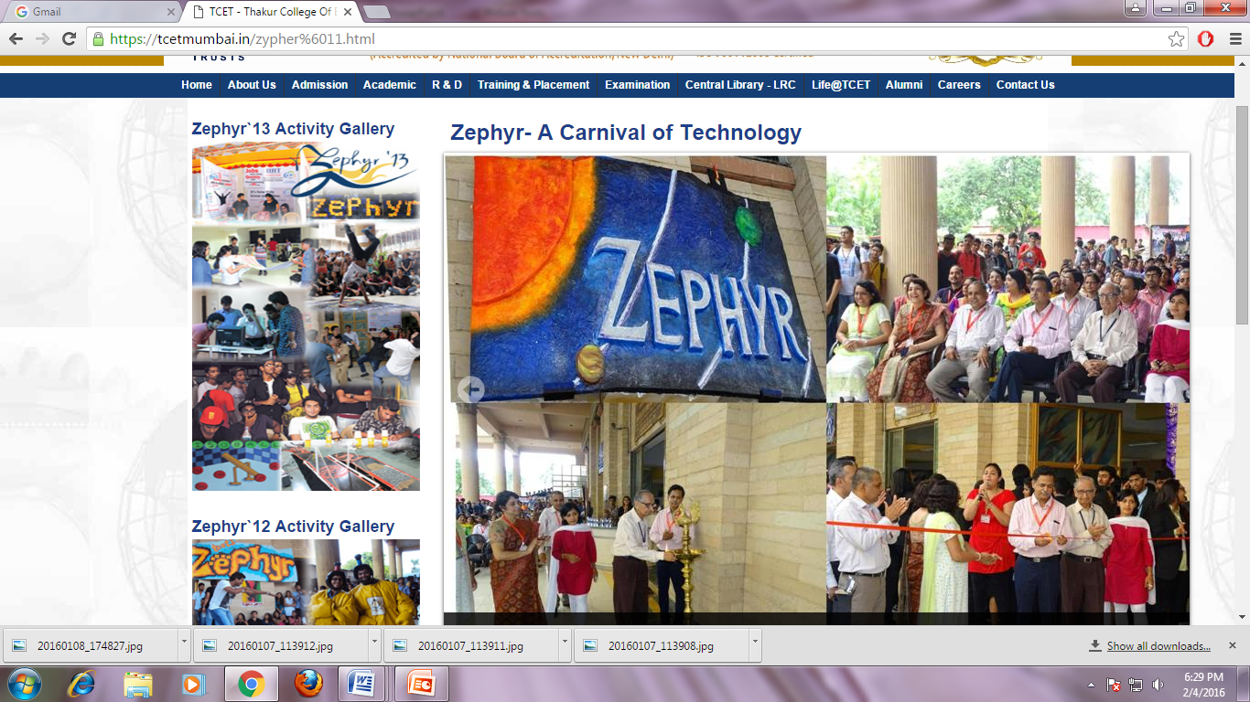
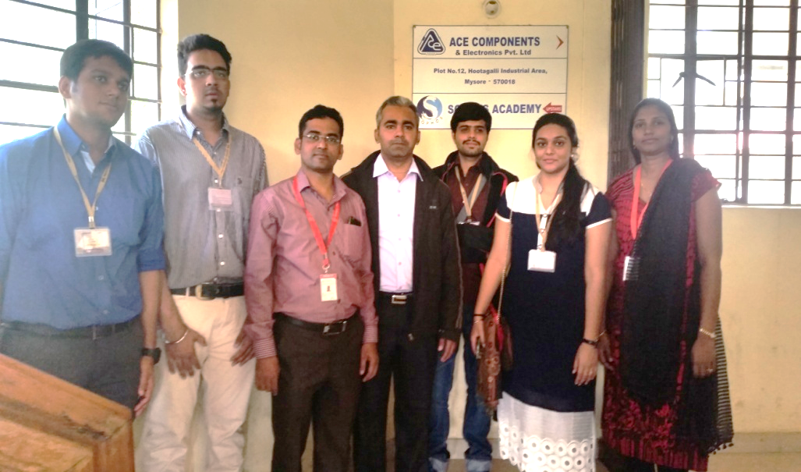
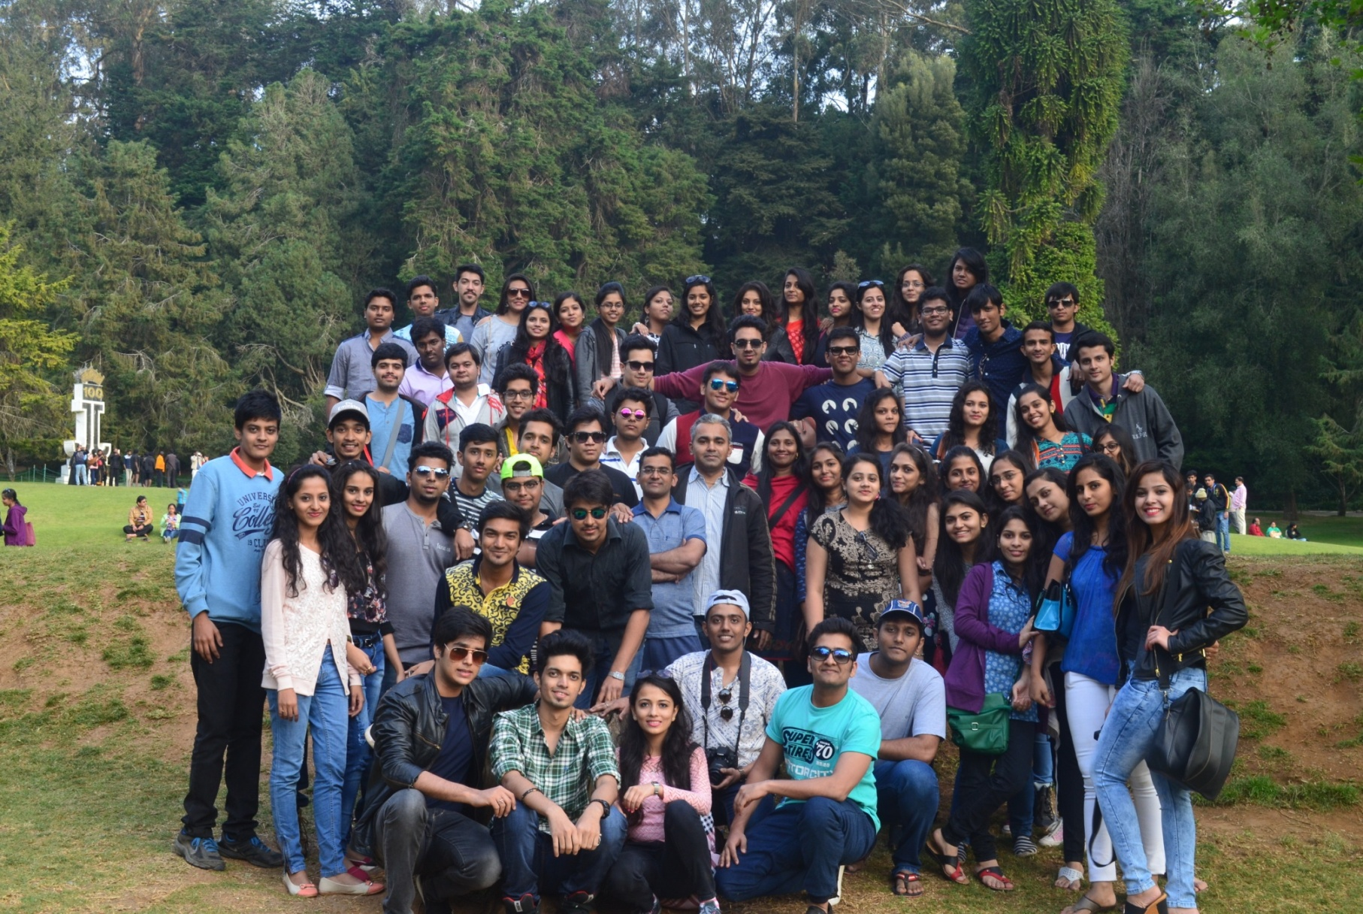
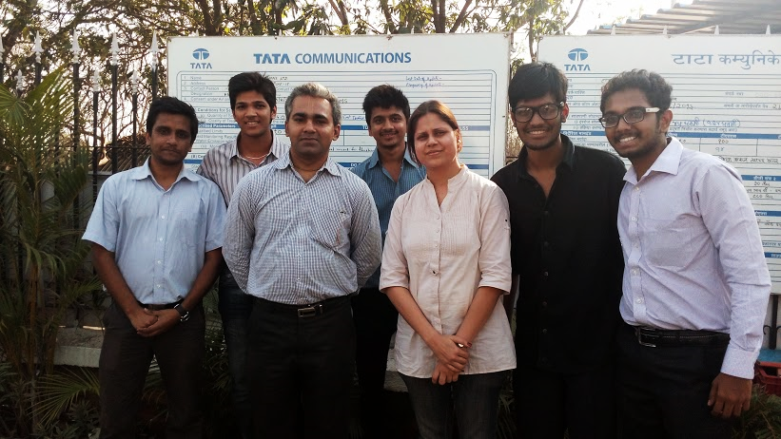
Glimpses of TCET-ACM Activities

Slide 78
Students Placements, Higher Studies and Entrepreneurship

Slide 79
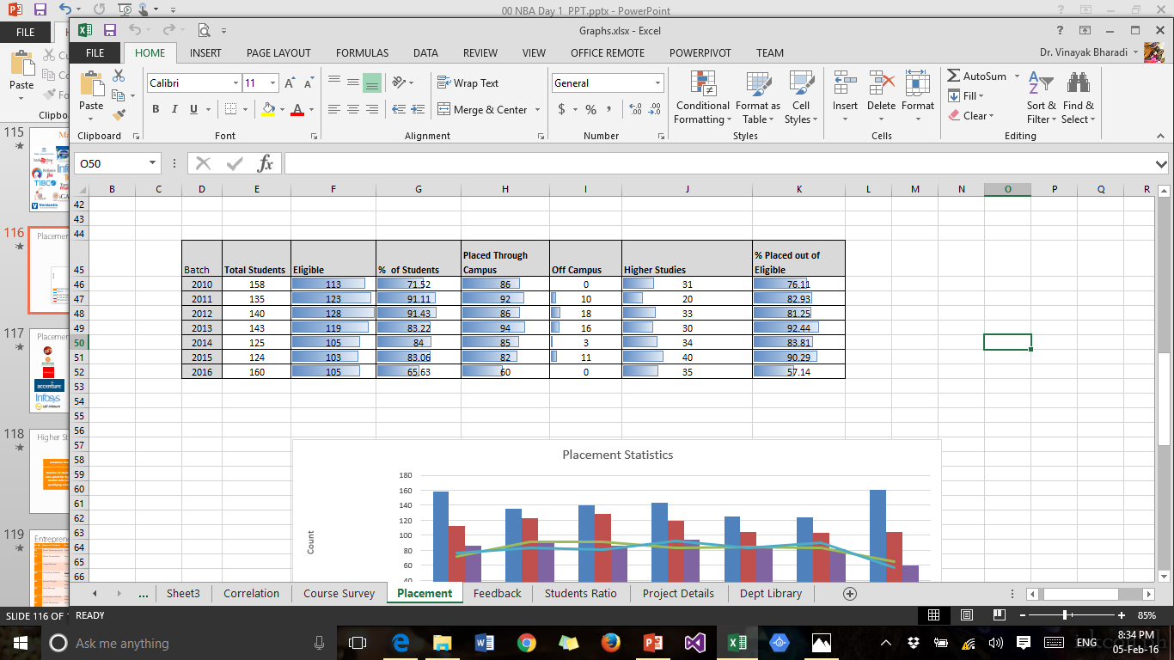
Placement Statistics
AY 2015-2016 Placement in Progress

Slide 80
Entrepreneurs
Sr. No. | Name of Student | Batch of passing | Branch | Company Name | Website Name | Contact No
01 | Pratik Parasrampuria | 2013 | IT | Owner of Pratik Web Solutions | www.pws.in.net
02 | Pratik Khanedlwal | 2013 | IT | Founder & CEO of Pragati Enterprise | www.indiamart.com/pragati-enterprise-mumbai/ | 9967435555
03 | Khushboo Gadhia | 2013 | IT | Purple Squirrel EduventuresPvt.Ltd. khushboo@purplesq.com | www.purplesq.com
04 | Avinash Singh | 2012 | IT | Director at SLangCode avinash@slangcode.com | www.slangcode.com
05 | Sunil Maurya | 2008 | IT | MAURYA CONSULTANCY SERVICES | www.mcslinc.com | 9076340505 9769351398
06 | Paresh Sojitra | 2007 |  | Founder of FELIX IT systems | www.felix-its.com
07 | Manan Shah | 2010 | IT | Founder - Housey.com |  | 9029380577
08 | Rahul Kanojia | 2014 | IT | Funder- Diplomad | www.diplomads.com | 8898681393
09 | Tanvi Kapdi | 2013 | IT | Bizotic |  | 9819959954
19 | Ramkrishna Parsana |  |  | Founder – Haven Industries |  | 8879558013
11 | Pranav Upadhyay | 2010 | IT | Co founder – Pulse EDU Concepts |  | 9819903112

Slide 81
Entrepreneurs
Sr. No. | Name of Student | Batch of passing | Branch | Company Name | Website Name | Contact No
12 | Irfan Ahmad | 2012 | IT | Fonder – TRILL IT | www.trill-it.com | 8108814088
13 | Pankit Chheda | 2011 | IT | Founder - MassBlurb |  | 9819210461
14 | Simran Arora | Student | IT | Founder – Pulse Lectronics | www.pulseelectronic.audio | 7738888817
15 | Ankit Solanki | 2012 | IT | Redbulls |  | 9987014301
16 | Nikhil Malvankar | Student | IT | Founder of Game Eon Pvt. ltd | www.gameeon.in | 9987736234
17 | Dhruv Shah | Student | IT | Founder- Zappazap | www.zapaazap.com | 8080233354
18 | Apporva Joshi | 2013 | IT | Funder – Aporva Creation & J K enterprise | www.aporva_joshi.com www.dryfruitboxes.com | 9619012240
19 | Jain Amit | 2012 | IT | Director – Ellvee mills pvt ltd |  | 9766579894
20 | Pratik Narsingpura | 2011 | IT | CEO & Founder – Jane & Associate |  | 9765258695
21 | Vaishnav Mohnish | 2011 | IT | Founder – Shopicorn , comedy flavors |  | 9867568974
22 | Karan Agrawal | 2010 | IT | Palghar Coil Product Ltd |  | 9769635510

Slide 82
Students Achievements

Slide 83
Rank Holders at University Level
1st Rank in Mumbai University
Surabhi
Khandelwal (2009)
2nd Rank in Mumbai University
Shreya Khandelwal (2010)
3rd Rank in
Mumbai University
Abhinaya Shetty
(2011)
Bhandari Priyanka scored 78.40% and stood 9th in the university merit list. (2014)
Mrinmayee Shirodkar
scored 79.95% and stood 22nd in the university merit list. (2015)

Slide 84
Students Publication Data
Domain | 2010-2011 | 2011-2012 | 2012-2013 | 2013-2014 | 2014-2015 | Publication
Data Communication network |  | 3 | 2 | 8 | 3 | 16
Database Management System |  |  |  | 5 | 14 | 19
Operating System |  |  | 2 | 1 | 1 | 4
Signal processing | 2 | 1 | 2 | 11 | 2 | 18
Software Engineering |  |  |  | 31 | 28 | 59
Total | 2 | 4 | 6 | 56 | 48 | 116
Last NBA – 03 Publications by Students
Sr. | Domains (For AY 2015-2016) | Papers Submitted to ICCCV 2016**
1 | Ubiquitous Computing | 2
2 | Digital Signal Image Processing, Soft Computing & AI | 3
3 | Database Technologies | 12
4 | Web Technology and E-commerce | 7
5 | Information and Communication Technology | 10
 | Total | 35

Slide 85
Students’ Achievements at a Glance
Student’s Awards Achievement | No. Of Students
Project Exhibition on National level | 23
Best paper presentation at National level conference | 06
Other Awards | 06
Best debut award from National Entrepreneurship Network on National level | 03
TECHBIRTH Event | 03
ISTE Srinivas Ramanujan Mathematical Competition | 01
Certification Achievements | No. Of Students
OCJP CERTIFICATION | 11
LINUX TRAINING | 07
FOSS TCET | 06
GREAT MIND CHALLENGE IBM | 04
PYTHON TRAINING | 03
ACM-ICPC | 03
WORKFORCE DEVELOPMENT PROGRAM | 02
MICROSOFT STUDENT PARTNER PROGRAM TRAINING | 01
GAME PROGRAMMING USING C# | 01
Participation in Co and Extra Curricular Activities | No. Of Students
Bridge Course | : 200+
WEBZINE Website Development Competition | : 75
Multicon-W Paper Presentation | : 69
Industrial Visit | : 64
Webinar on Microsoft Talent India | : 45
E-Week | : 42
Mini Project Competition | :30
Achievement
Twenty two (22) Entrepreneurs till date
Ankit Khetan secured 99.99 percentile in CAT
Aakash Mamtani Got package of 34 lacs
Tanvi Kapdi Started company “BIZOTICS” with TCET Incubation Centre
25% students opted for Higher Studies in A.Y. 2015-16
Second Rank in Technical Project Presentation in National Conference at Universal CoE, OCT 2015 by BE IT A Students

Slide 86
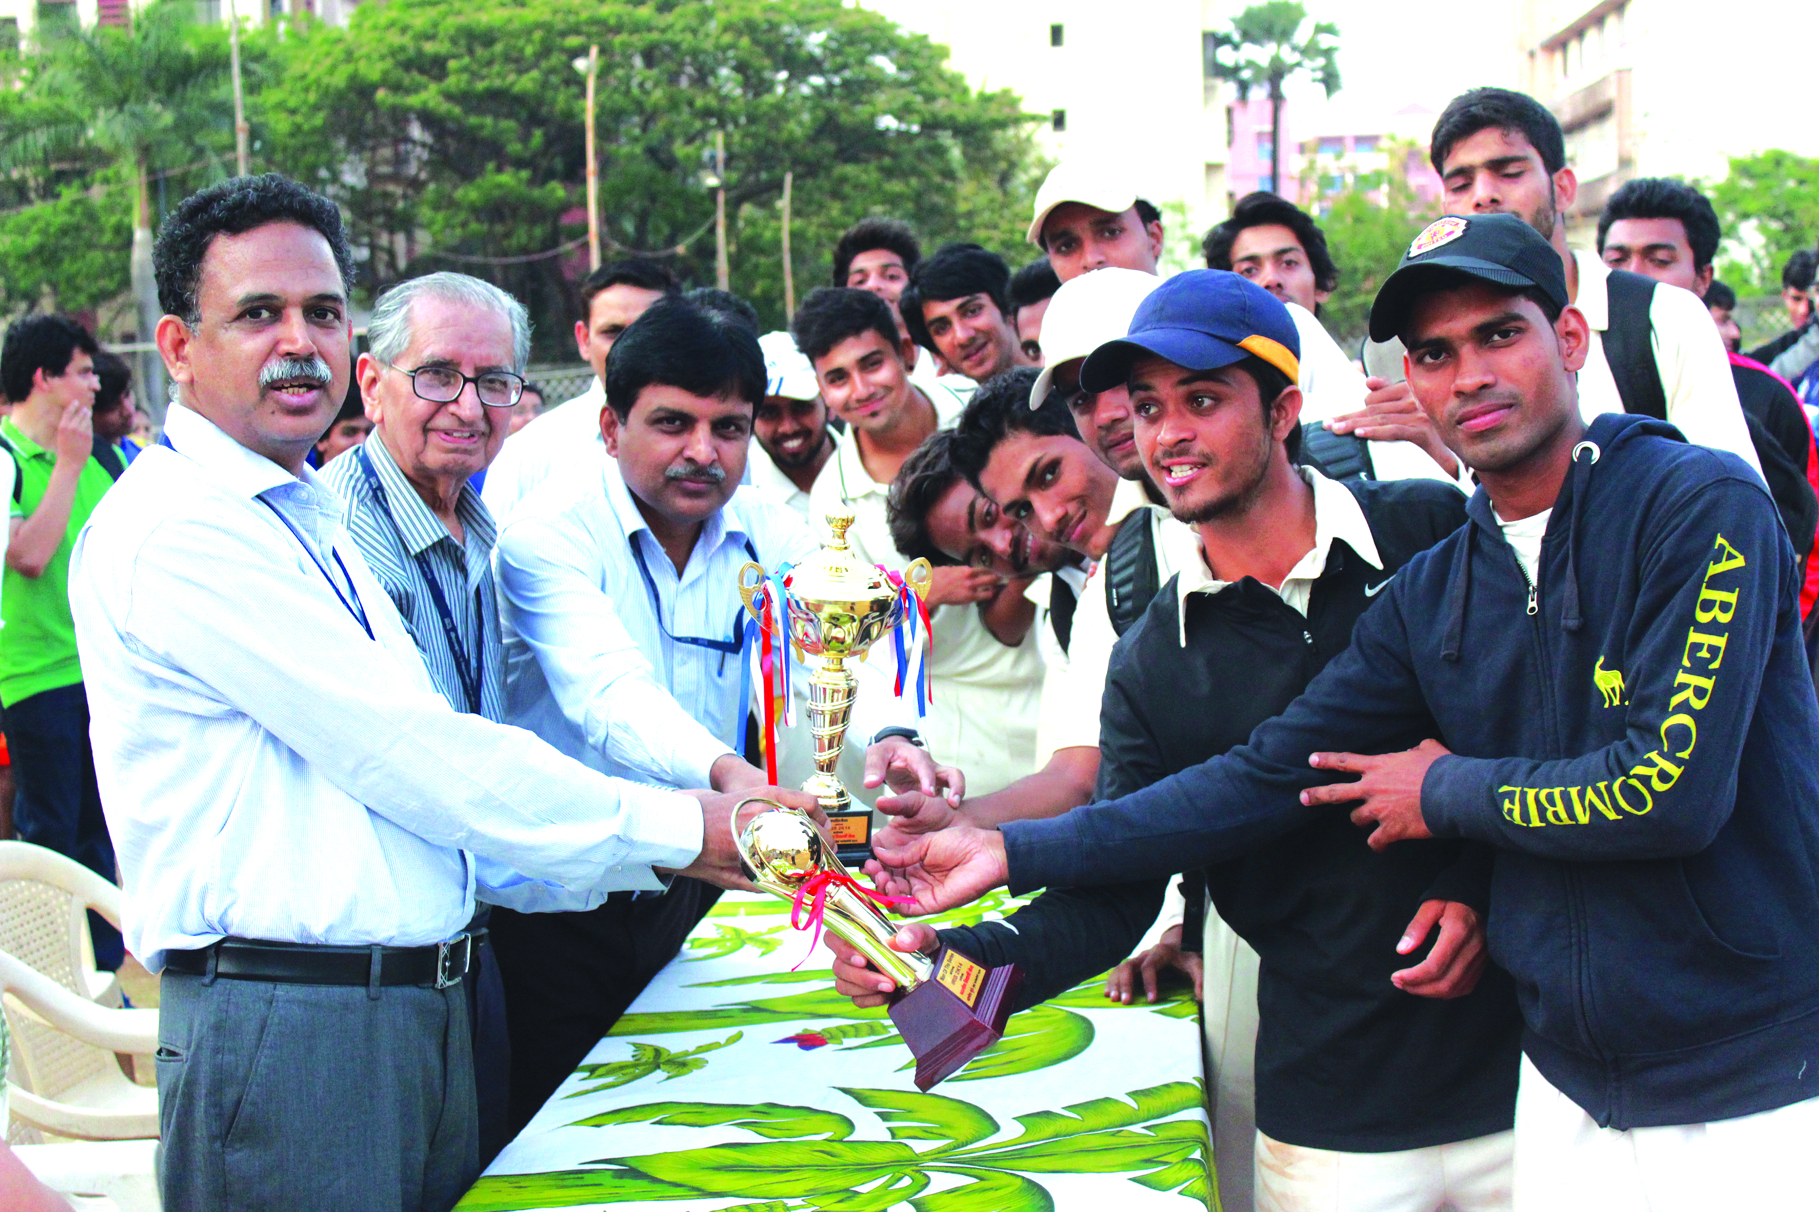
Sports Achievements
Satyendra Yadav SE IT B, Winner for Regional Level Basketball, 2015
At Southern Command Pune
Padmaja Shukla, SEIT B, Karate Winner at Aisian Level Championship, Black Belt Certified. (2015)
Atul Mishra SE IT B, 2nd Runner up, Inter College Chess Competition, Ramnarain Jhunjhunwala College, Mumbai, 2015
Kanishk Verma BE IT A, Hockey Under 17 District Winner, Hockey Under 16 District Runner up (2015), Lazzium Zone Winner (2010)
Cricket: TCET Cricket team won many awards at BOSM13 Open Sports meets organized by BITS, Pilani, Rajasthan in September 2013. It was winner in the event Box type cricket and overall the third runner ups.
Cricket tem also won the Inter-collegiate sports tournament at RGIT, Mumbai, was runner ups in Inter-collegiate sports tournament at SFIT, Mumbai, and ENERTIA’ 14 organized by TCET in March 2014

Slide 87
Faculty Development and Research Activity

Slide 88
Faculty Domains
DCN
Mr. Rajesh Bansode
SE
DBMS
Mrs. Hetal Amrutia
ELEC & Signal Processing
Dr. Kamal Shah
Operating Systems
Mr. Vikas Kaul
Mr. Zahir Aalam M.M
Mr. Aaditya A. Desai
Mrs. Hetal Amrutia
Mrs. Pranjali Kasture
Ms. Neha Kapadia
Mrs. Purvi Sankhe
Mrs. Mary Margarat
Mr. Bhushan Nemade
Mrs. Pranjali Kasture
Ms. Neha Kapadia
Mr. Namdeo B. Badhe
Mr. Rahul Neve
Ms. Vandana Munde
Mr. Vijaykumar Yele
Dr. Vinayak Bharadi
Dr. Bijit Marakarkandy
Mr. Rajesh Bansode
Mr Vikas Kaul
Ms. Sinora Ghosalkar
Mr. Zahir Aalam M.M.
Ms. Sangeeta Vhatkar
Namdeo Badhe
Anil Vasoya

Slide 89
Faculty Domains
Ubiquitous Computing
Mr. Aaditya A. Desai
Digital Signal Image Processing, Soft Computing & AI
Database Technologies
Mr. Namdeo B. Badhe
Web Technology and E-commerce
Mrs. Hetal Amrutia
Ms. Neha Kapadia
Mrs. Purvi Sankhe
Mrs. Pranjali Kasture
Mrs. Mary Margarat
Mr. Bhushan Nemade
Mr. Shridhar Kamble
Dr. Kamal Shah
Dr. Vinayak Bharadi
Dr. Bijith Marakarkandy
Mr. Rajesh Bansode
Mr Vikas Kaul
Mr. Vijaykumar Yele
Ms. Smita Chaturvedi
Ms. Vandana Munde
Mrs. Hetal Amrutia
Mrs. Pranjali Kasture
Ms. Neha Kapadia
Mr. Rahul Neve
Mr. Shridhar Kamble
Dr. Bijith Markarkandy
Mrs. Pranjali Kasture
Mr. Namdeo Badhe
Ms. Ratna Nayak
Mr. Shridhar Kamble
Information and Communication Technology
Mr. Rajesh Bansode
Ms. Sangeeta Vhatkar
Mr. Vikas Kaul
Mr. Zahir Aalam M.M.
Ms. Fiona L
Dr. Deven Shah
Dr. Deven Shah

Slide 90
Domain Wise Activity AY: 15-16
Domain | Activity -2015-16 | Participation
Ubiquitous Computing | 1.Setup of Hybrid Cloud in Virtual Cloud Computing LAB 2. Technical Seminar: Open Source Technologies on 29/07/15 by Mr. Amod Naverkar(Software Developer- Mozilla OS) for Third Year Students | Cloud Storage is setup for IT Department Faculty TE IT total 120 Students participated
Digital Signal Image Processing, Soft Computing & AI | STTP on IT Tools in Dec 2015 | Faculty form IT and Computer Department will be attending the STTP
Database Technologies | Technical Seminar: Open Source Database Technologies on 29/07/15 by Mr. Amod Naverkar(Software Developer- Mozilla OS) for Second Year Student | SE IT - Total 126 Students attended the Seminar
Web Technology and E-commerce | Technical Seminar: Internet of Things on 31/07/15 by Mr. Naman Singh(Software Developer- DuckDuckGo) for Final Year Student | BE IT – total 134 Students attended the Seminar
Information and Communication Technology | STTP on WSN, NS2 | Faculty from IT and EXTC Department will participate in the STTP.

Slide 91
Publication and Citation Details
Sr. | Faculty Name | Citations | h-index | i10index
1 | Dr. Kamal Shah | 86 | 4 | 1
2 | Dr. Deven Shah | 57 | 5 | 2
3 | Dr. Vinayak Bharadi | 308 | 9 | 9
4 | Mr. Vikas Kaul | 10 | 2 | 0
5 | Mr. Rajesh Bansode | 21 | 3 | 0
6 | Mr. Zahir Aalam M.M. | 4 | 1 | 0
7 | Dr. Bijith Marakarkandy | 12 | 3 | 0
8 | Mrs. Vandana Munde | 1 | 1 | 0
9 | Mrs. Pranjali Kasture | 2 | 1 | 0
10 | Ms. Sangeeta Vhatkar | 7 | 2 | 0
11 | Mr. Bhushan Nemade | 82 | 5 | 3
12 | Mr. Aaditya A. Desai | 2 | 1 | 0
13 | Mrs. Hetal Amrutia | 1 | 1 | 0
14 | Mr. Shridhar Kamble | 1 | 1 | 0
15 | Mrs. Mary Margarat | 4 | 1 | 0
16 | Mrs. Fiona Lawrence | 2 | 1 | 0
17 | Ms. Ratna Nayak | 6 | 2 | 0
 | Total Sum | 606 | 43 | 15
289 Publications Till Date (Last NBA – 121)
Source : Google Scholar

Slide 92
Upgradation Qualification Details
Academic Year | PhD Completed | PhD Pursuing | Post Graduates (PG) Completed | Post Graduates (PG) Pursuing | Graduates (BE)
2010-2011 (Last NBA) | 0 | 4 | 8 | 8 | 8
2015-2016 | 4 | 6 | 17 | 3 | 0

Slide 93
Grants/Funding Received
Sr. | Faculty Name | Academic Year | Grant Details | Utilization
1 | Dr. Kamal Shah | 2012-2013 | AICTE MODROBS Grant of INR 7.2 Lacs for Development of VCC Lab | Virtualization and Cloud Computing Lab C-301 was developed in AY 2013-2014
2 | Dr. Vinayak A Bharadi | 2014-2015 | Microsoft Educator Grant in terms of Azure Subscription Worth INR 16 Lacs | Cloud Computing Subject of BE IT AY 204-2015 Even Semester, AY 2015-2016 Odd Semester
3 | Dr. Bijith M. | Nov 2012 | Mumbai University Minor Research Grant of INR 12,000 | Face Recognition Project
4 | Mr. Rajesh Bansode | Nov 2012 | Mumbai University Minor Research Grant of INR 15,000/ | PAPR Reduction Project
5 | Ms. Hetal Amrutia | Dec 2013 | Mumbai University Minor Research Grant of INR 25,000 | Attendance Monitoring System
6 | Dr. Kamal Shah, | Dec 2015 | IEDC Grant of INR 01 Lac is Recommended | Final Year Project
7 | Mr. Anil Vasoya | Dec 2015 | IEDC Grant of INR 01 Lac is Recommended | Final Year Project

Slide 94

Faculty Achievement
Infosys Campus connect Partnership Certification(June -2015)
Faculty Name | Partnership Level By Faculty
Aditya Desai | Silver
Vandana Munde | Silver
Pranjali Kasture | Bronze
Namdeo Badhe | Silver
Sangeeta Vhatkar | Silver
Bhushan Nemade | Silver
Mary Margrat | Bronze

Slide 95
International Conference
Conference | International Affiliation | Submissions | Selections | Acceptance Rate | Participants
ICWET 2010 | ACM USA | 622 | 284 | 45.66 | 750
ICWET 2011 | ACM, IJAIS | 587 | 222 | 37.82 | 700
ICWET 2012 | IJCA | 580 | 115 | 19.83 | 357
ICWET 2013 | IJCA, IJAIS | 527 | 92 | 17.46 | 324
ICWET, ICWAC 2014 | IJCA, IJAIS | 450 | 55 | 12.22 | 152
ICWET, ICWAC 2015 | IJCA, IJAIS | 310 | 50 | 16.13 | 155
ICCCV 2016 | Elsevier, IJCA, IJAIS | 333 | 128 | 38.43 | 500+

Slide 96
Mentoring and Department Level
TG Effectiveness

Slide 97
Mentoring system to help at individual levels
A Teacher Guardian book is maintained for each student where details like
  Students details
  Academic Record metric level onward
  Academic Performance
  Event participation
  Publication
  Membership of professional bodies
  Competitive Examination Details
  Counselling details : for all applicable reasons pertaining to students academic progress
  Co-Curricular and Extra-Curricular activities.

Slide 98
Classification of Students as per their Academic Performance
Roll No. | Name | A.Y 2012-13(SE) | A.Y 2013-14(TE) | A.Y 2014-15(BE) | Company in which placed | Achievement /award
1 | SwapnaliPadwal | A | A | A
3 | Jyoti Bansal | A | A | AA | INFOSYS
4 | Alpesh Bapna | A | A | A
5 | Sejal Bhagwat | A | A | A
6 | Drishti Bhati | A | AA | AA | ACCENTURE
7 | Nikita Deepak | A | BA | A
8 | Vinodkumar Nemaram | A | A | A
9 | Shashikant Chauhan | A | A | A
10 | Sushil Chaurasia | A | A | A | INFOSYS
11 | Sneha Chendvankar | A | A | AA
12 | Vinay Chaudhari | A | A | A | INFOSYS
13 | Jay Darji | A | A | AA | INFOSYS
14 | Siddhesh Dhotre | A | BA | A | INFOSYS
15 | Dwivedi Saranjh | BA | A | A | L&T
16 | Akshay Anbhawane | BA | AA | AA | ACCENTURE
17 | Prathamesh Gawade | A | AA | A | ACCENTURE
18 | Jinal Mehta | A | A | AA | INFOSYS
20 | Abhijeet Gupta | A | A | BA
21 | Dheeraj Gupta | A | A | A | IGATE

Slide 99
Name of the student : Ms. Swapnali Padwal Class : BEIT-A Academic Year : 2011-12 to 2014-15
FE
 | Sem-I | Sem-II
Attendance | 63.4 | 70
TT-I | 49.6 | 46
TT-II | 54 | 51
University Result | 59 | 52
AT/KT | 2
SE
 | III | IV
Attendance | 75 | 82
TT-I | 55 | 69.3
TT-II | 53.3 | 59.3
University Result | 65.8 | 67.05
AT/KT | 0
TE
 | V | VI
Attendance | 84.6 | 89
TT-I | 80.3 | 83.3
TT-II | 64.3 | 76
University Result | 75 | 75.2
AT/KT | 0
BE
 | VII | VIII
Attendance | 80.3 | 84
TT-I | 76.8 | 71
TT-II | 72.8 | 72.5
University Result | 70 | 72
AT/KT | 0

Slide 100
Progress form FE to BE

Slide 101
Admission Quality (Entry Level Marks for IT Dept.)
Rank Range | 2015-2016 | 2014-2015 | 2013-2014 | 2012-2013 | 2011-2012 | 2010-2011
More than 98 percentile | 0 | 0 | 0 | 0 | 0 | 0
95 – 98 percentile | 0 | 1 | 0 | 1 | 0 | 0
90 – 95 percentile | 15 | 10 | 0 | 0 | 0 | 0
80 – 90 percentile | 42 | 29 | 1 | 1 | 0 | 1
70-80 percentile | 10 | 19 | 8 | 9 | 3 | 19
60-70 percentile | 18 | 18 | 7 | 26 | 19 | 28
50-60 percentile | 26 | 28 | 39 | 21 | 44 | 20
Below 50% percentile | 33 | 22 | 66 | 63 | 55 | 53
Admitted Without Rank | 0 | 0 | 0 | 0 | 0 | 0
BACK

Slide 102
Overall Improvement Since Last NBA Accreditation

Slide 103
Compliance to the Comments of Previous NBA Committee
There is no Professor and Associate Professor
Two (02) Professors
Research and Consultancy Culture is weak
Started R&D Cell, TCET Accenture Innovation Centre
Four Associate Professors
Hired two teaching assistants for labs, currently IT department has Nine Support staff.
Total 289 Publications with 600+ citations from AY 2011-12 to Present
Students have Published 116 Papers at National and International Level
Four Consultancy Projects
Two faculty members completed their PhD, Currently six (06) faculty members are pursuing their PhD, Seventeen (17) faculty are ME/Mtech. Completed
One AICTE Grant, Three Minor Research Grants form UoM, Two IEDC Grants and One Microsoft Educator Grant
Staff needs to be strengthened by giving them opportunity to upgrade their qualification and skills
Faculty upgrading their qualification and skills by attending STTP organized by IITB remote Centers, Organizing STTP. Successfully organized three STTPs in IT department in last four academic years.
Participation in train the trainer program by Infosys
The technical and support staff in the Department is Poor
Two (02) Lab Assistants, Two (02)Teaching assistants Seven (05) lab attendants.
Organized conferences such as ICWAC 2015, MulticonW 2012- to 15, currently 7th International Conference ICCCV 2016 is being organized.

Slide 104
Overall Improvements
Infrastructure
Lab 203, 204 Renovated
ICT
CCTV Cameras, ICT Infrastructure Upgrade5
Projectors in Labs and Classroom
Faculty
Lab C 301 Developed as VCC Lab (AICTE MODROBS)
Staffroom Renovation, HOD Office
2 Professors were recruited,
Technical Staff in Labs (Teaching Assistant)
4 PhDs, 6 PhD Pursuing, 17 MTech
Internet Bandwidth increased to 14 Mbps, will be upgraded to 54 Mbps
Microsoft Campus License
Cloud based Storage for IT Department through VCC
Research
289 Publications with 600+ Citations
6 Conferences
Accenture Innovation Center
Training through IITB Remote Centers and STTP
4 Associate Professors, 17 Assistant Professors
TCET Accenture Innovation Center – INR 22 Lacs, 30 PC and 01 IBM Server
One Major, Three Minor Grand, Two IEDC Grants, Microsoft Grant

Slide 105
Projections
Placement Opportunities for Non-Eligible Students
IT for Rural Development
IT for National Security
IT for Healthcare
IBM Excellence Center
International Industrial Visit
Collaboration with International Universities

Slide 106
Conclusion
100% Admission, Improvement in Quality of Students
OBE
Consistent
PO and PEO Attainment
Consistent Success rate with average 77%
Consistent in achieving the Quality Objectives
Consistent campus placements & higher studies
Qualified Faculty & well Equipped labs

Slide 107
Thank You..
Honorable NBA Committee

Slide 108
Thank You……

Slide 109
Infrastructure
Labs, Classrooms, Staffrooms Details

Slide 110
Department Infrastructure (UG Course)
No. of Classrooms | Average Capacity | Teaching Aids Available | Other Facilities | Remarks
06 UG | 80 (UG) | Blackboard, Screen, Multimedia Projection Facility, Portable Speaker | Single Seat benches Air conditioned classrooms, Internet Connection | With the Department
08 Labs | 36 | Blackboard, Screen, Multimedia Projection Facility, PC , LAN, Internet Facility | Table, Chair, AC, Fan, | With the Department
01 Tutorial Room | 36 | Internet Facility | Table, Chair, AC, Fan, | With the Department
02 (SH1, SH2) 01 (Auditorium) *01 (SH3) Central Library | 120 600 200 250 | Blackboard Audio System, Multimedia Projection Facility Chairs, AC | Single Seat benches Air conditioned classrooms , Internet Connection, Access to online content, AV Room, Digital Library | Shared with other Departments
Canteen | 150 | NA | Dining Area, Counter, Kitchen with Modern amenities, Fire extinguisher , Separate Wash basin, Drinking water facility | Institutional facility
BACK
Notes:
Create

Slide 111
Classrooms - IT UG
Room Description | Usage | Capacity | Area Sq. Mt. | Rooms Equipped with
Class Room No. 307 | 4thyear (A Div) | 80 | 87.36 | Blackboard, Screen, Multimedia Projection Facility, Portable Speaker, , Internet Connection
Class Room No. 308 | 4th year (B Div) | 80 | 87.36
Class Room No. 309 | 3rd year (A Div.) | 80 | 87.36
Class Room No. 310 | 3rd year (B Div.) | 80 | 87.36
Class Room No. 311 | 2nd year (A Div) | 80 | 87.36
Class Room No. 312 | 2nd year (B Div.) | 80 | 87.36
BACK

Slide 112
Laboratory – IT UG
Lab No. | Lab Name | Capacity | Area Sq. M | Subjects Conducted | PEO | PO | Facility
202 | Programming Languages Lab | 36 | 87.36 | SPA | 1,2,3,5 | 1,2,3,4,5 | CCTV, Computers, Internet Connection Projectors, Chairs, AC, Light, Fan, Racks, Switches, Stabilizers, Dot Matrix printers
 |  |  |  | CGVR, DBMS, IP, OS, IS, DSA, WT
203 | Signal and Image Processing lab | 36 | 87.36 | WP,BDA,SE,STQA,AIT | 1,2,3,5 | 1,2,3,4,5
 |  |  |  | MMS, DBMS, ADBMS, OS, IS
C-204 | Programming Languages Lab | 36 | 87.36 | SPA | 1,2,3,5 | 1,2,3,4,5
 |  |  |  | CGVR, OST, SPM, Project
C-301 | Virtualiation Cloud Computing Lab | 36 | 74.25 | DS, STQA,CN,DS,SE | 1,2,3,5 | 1,2,3,4,5
 |  |  |  | CC, WT, Project
206 | System Software Lab | 36 | 74.25 | ED(AUTO-CAD) | 1,2,3,5 | 1,2,3,4,5
 |  |  |  | MCES, SPM, ADBMS, ECEB, Project
207 | Project Lab | 36 | 74.25 | STQA, DMBI, SWS, SE, BE-PROJECT | 4,6,7 | 6,9,10,12
 |  |  |  | Project, CGVR, DSA, ECEB, SPM
213 | TCET Accenture Innovation Center | 36 | 87.36 | STQA, DMBI, SWS, SE | 1,2,3,5 | 1,2,3,4,5, 11
 |  |  |  | OOP, ECEB, ADBMS, IS, SPM, DSA, WT
313 | Hardware Lab | 36 | 74.25 | SNMR, COA,DS, CN | 1,2,3,5 | 1,2,3,4,5
 |  |  |  | PADC, ADC, WT, MCES, DSA
BACK

Slide 113
Laboratory Cost Details
Sr. No | Name of Article | Lab- 202 Amount | Lab- 203 Amount | Lab- 204 Amount | Lab- 205 Amount | Lab- 206 Amount | Lab- 207 Amount | Lab- 213 Amount | Lab- 313 Amount
1 | Computers | 9,36,000.00 | 13,14,000.00 | 10,36,000.00 | 13,14,000.00 | 9,36,000.00 | 7,73,999.27 | 16,56,000.00 | 10,08,000
2 | Dot Matrix Printer (EPSON) | 13,700.00 | 16,550.00 | 13,500.00 | 13,500.00 | 13,500.00 | 13,500.00 | 21000 | 18,499.00
3 | 7.5 K.V.A. STABILIZER | 20,754.00 | 29,812.50 | 13,877.50 | 21,563.33 | 20,754.00 | 20,000.00
4 | N/W 24 & 16 PORT PATCHPANEL, 19”RACK | 73,343.00 | 59,740.00 | 94,772.00 | 106538 | 78,516.50 | 78,516.50 | 7,172.00 | 70,880.00
5 | In Focus Projector IN 114 | 26,250.17 | 26,250.00 | 26,250.17 | 26,250.00 | 26,250.00 | 26,250.00 | 26,250.00
6 | Dell power Edge Rs20 server |  |  | 6,09,000.00
7 | Hardware Equipment |  |  |  |  |  |  |  | 11,12,034.00 | Total Lab Cost
 | Total | 10,70,047.17 | 14,46,352.00 | 17,93,399.67 | 14,81,851.33 | 10,75,020.50 | 9,12,265.77 | 17,10,420.00 | 10,97,379.00 | 1,05,86,737.44

Slide 114
Staff Room and Discussion Room
Room Description | Usage | Capacity | Rooms Equipped with
HOD IT Cabin C-105 | HOD IT Seating Arrangement, Faculty Meeting Room | 1+6 | Internet, AC, Table, 7 Chairs, Intercom
Meeting Room-Lab no. 203, 204,205 | Departmental meeting, Counseling of Students | 09 | Internet Connection, Chairs
Faculty room-I | Lecture Preparation, Discussion. | 18 | PC(06 Nos.), Internet, White Board, Notice Board, 16 Cubicles & 2 Cabins.
Faculty Room-II
 |  | 09 | PC(04 No.), Internet, Book rack, White Board, Notice Board, 9 Cubicles
Counseling Room | Teacher Guardian Counseling of Students | 20 | Cubicles, Chairs for students counseling
Department Library | Lecture Preparation, Reading | 04 | 500+ Books, Reports, Chairs, Table , Internet Connection, PC
BACK

Slide 115
Software license Details
Sr. No. | Equipment Identification | Softwares | Quantity | Purchase Date | Amount
1 | TCET/S/0203/67/IT/1 | Norton Antivirus | 1 | 31/08/2002 | 8500.00
2 | TCET/S/0203/90/IT/2 | 3D Max Studio ae | 1 | 30/11/2002 | 49,000.00
3 | TCET/S/0203/91/IT/3 | Adobe Publishing Collections ae | 1 | 30/11/2002 | 25,500.00
4 | TCET/S/0203/92-94/IT/4-6 | Macromedia Studio Mx ae Paper Lic | 3 | 30/11/2002 | 25,500.00
6 | TCET/S/0405/226-230/IT/8-12 | M.S. Office 2003 Lic | 5 | 2/02/2005 | 11,000.00
7 | TCET/S/0405/291/IT/13 | M.S. Office 2003 Media Kit | 1 | 2/02/2005 | 1,500.00
8 | TCET/S/0405/292-341/IT/14-63 | Turbo C/C++ | 50 | 2/02/2005 | 1,00,000.00
9 | TCET/S/0405/342-351/IT/64-73 | Rational Rose | 30 | 2/02/2005 | 3,00,000.00
10 | TCET/S/0506/352/IT/74 | Norton Antivirus 10 | 1 | 29/11/2005 | 12,200.00
11 | TCET/S/0506/479-498/IT/75-94 | M.S. Visual Studio Pro 2005 | 20 | 31/03/2006 | 1,67,400.00
12 | TCET/S/0506/499/IT/95 | M.S. Visual Studio 2005 Media Kit | 1 | 31/03/2006 | 1,200.00
13 | TCET/S/0506/588-607/IT/96-115 | Oracle 10g Database Std Edition | 20 | 31/03/2006 | 1,05,000.00
14 | TCET/S/0708/614/IT/117 | Software IBM Rational Suit (Media Kit) | 1 | 20/04/2007 | 11,515.00
15 | TCET/S/0708/615/IT/118 | 1 win STP server 2SQL Server Extrmconn | 01 | 4/07/2007 | 93,375.00
16 | TCET/S/0708/616/IT/119 | Autocad 2008, 20 User License | 20 | 17/03/2008 | 2,74,300.00
17 | TCET/S/08-09/617/IT/120 | Educational Bundle Solution for PCB Design | 01 | 14/10/2008 | 8,39,592.00
18 | TCET/S/09-10/619/IT/121 | XI Link software(25 user) | 25 | 22/09/2009 | 59163.00
19 | TCET/S/12-13/625/IT/122 | IBM Rational Enterprise suit | 01 | 26/10/2012 | 1,75,000
20 | Campus License | Microsoft Windows Products |  | 2012

Slide 116
Open Source Softwares Used
Sr. | Software | Subject | Class | Purpose
1. | Scilab | DSIP | BE IT | Signal and Image Processing Programs, Alternative to Matlab
2. | Ubuntu Desktop 15 | CC, OST, BDA | BE IT, TE IT | Open Source Laboratory, Cloud Computing Practical
3. | OpenStack Kilo | CC | BE IT | IaaS Demo in Cloud Computing
4. | XenCenter 6.52 | CC | BE IT | Virtualization laboratory
5. | Eclipse IDE Mars | CC, SPA | BE, TE | Java Programming
6. | PHP, MySQL, Postgre SQL | DBMS, WP | SE | Database Management Systems Labs

Slide 117
Hardware Resources (Lab 313)
Sr. No | Type of Equipment | Description | Quantity | Amount
1 | Power Supply | Scientific power supply Model PSD 3304 | 14 | 155925.00
2 | Function Generator | Scientific Model No FG2MD | 14 | 98035.00
3 | Oscilloscope | Aplab30 MHz (2ch 4 Trace) 3803 | 14 | 227136.00
4 | Digital Multimeter | Mastech M-92A | 14 | 14175.00
5 | Solderless Bread Board | ____ | 14 | 2244.50
6 | Microcontroller Kit | Microcontroller kit WithLCD Display Keybord | 6 | 43929.60
 |  | 8086 UP Kit with LCD& Keyboard | 6 | 52141.44
 |  | 8255With Converter card Study card | 6 | 12480.00
 |  | Stepper motor kit with DC motor 12V | 6 | 15587.50
 |  | Scanning Techniques illustrating 8X8LED Matrix4X4 keypad Display study card | 6 | 12342.72
BACK

Slide 118
Hardware Resources (Lab 313)
Sr. No | Type of Equipment | Description | Quantity | Amount
7 | PCOM KIT | A.M Transmission Receiver kit ASK PSK encoding Kits no. ST2201 ST2202 ST2106/2/07. | 3 | 49500.00
 |  | AM FC Generation& demodulation model no ST 2201 | 1 | 14000.00
 |  | AM SC,SSBSC generation & Demodulation | 1 | 14000.00
 |  | FM generation & demodulation model 2203 | 1 | 22500.00
 |  | Sampling of anolong signal model ST 2101 | 1 | 8250.00
 |  | Pulse analog modulation & demodulation model 2110 | 1 | 12500.00
 |  | TDM System model no ST 2102 | 1 | 9500.00
 |  | PCM Coding & decoding model no ST 2104 | 1 | 13500.00
 |  | Delta modulation & demodulation model no ST 2105 | 1 | 18500.00
 | PCOM KIT | ASK,FSK & PSK encoding model no ST 2106 | 1 | 27000.00
 |  | Scientech CDMA Digital DSSS Trainer Model ST 2131 GSM Trainer Model No. ST 2133 | 1 | 2,00,000.00
 |  | 33 Cool Runner, CPLD Model MXCK 100 | 1 | 13164.00
 |  | Sparten 3 IM Triner Model MXS3FK IM | 1 | 16754.00
8 | Consumable Components | ____ | 1 | 31506.80
BACK

Slide 119
Department Library Books
Central library procurement for department

Slide 120
Department Library Books
Sr | Author; title UG Medico | Pub | Price Rs. | req | Cost
1 | Bose, Rajan: Information theory & Coding | TMH | 565 | 3 | 1695.00
2 | Colin: Electronics & Communication | TMH | 829 | 3 | 2487.00
3 | Pfleeger: Security in computing | Pearson | 789 | 3 | 2367.00
4 | Forouzan: Cryptography & N/w security | TMH | 625 | 3 | 1875.00
5 | Mark Stamp: Information security, principals & security | Wiley | 579 | 3 | 1737.00
6 | Shmueli: Data mining for business intelligence | Wiley | 739 | 3 | 2217.00
7 | Vercellis: Business intelligence | Wiley | 519 | 3 | 1557.00
8 | Shibu: Intro to embedded systems | MgH | 550 | 3 | 1650.00
9 | Furber: ARM System on chip architecture | Pearson | 525 | 3 | 1575.00
10 | Das: Embedded system an integrated approach | Pearson | 509 | 3 | 1527.00
11 | Tomasi: Electronic comm system | Pearson | 919 | 3 | 2757.00
12 | Sinha, PK: Distributed operating system | PH | 450 | 2 | 900.00
13 | Couliris: Distributed systems | Pearson | 869 | 2 | 1738.00
14 | Mahajan, S: Distributed computing | OUP | 525 | 2 | 1050.00
15 | Sadashivam & Radhashankar Mani: Middleware & enterprise | Wiley | 579 | 2 | 1158.00
16 | Buyya: Cloud computing | Wiley | 629 | 3 | 1887.00
17 | Hwang: Distributed cloud computing | Elsevier | 550 | 2 | 1100.00
18 | Han & Kamber: Datamining; concepts & techniques -3e | Elsevier | 510 | 2 | 1020.00
19 | Rajaraman: Mining of massive datasets | Wiley | 599 | 2 | 1198.00
20 | Antally: Making sense of NoSQL | Wiley | 799 | 2 | 1598.00
21 | Linux: RHCE RedHat certified engineer…….? | TMH |  | 2 | 0.00
22 | Negus:Fedora 8 & Red Hat Enterprise edition Bible | Wiley | 599 | 1 | 599.00
23 | Sosinsky: Cloud computing bible | Wiley | 649 | 1 | 649.00
24 | Kanetkar: Data structures using C | BPB |  | 2 | 0.00
25 | Jarole & Pena: Web design & development black book | Coriolis Group |  | 2 | 0.00
26 | Enge & Spencer: The art of SEO | O'Reilly |  | 2 | 0.00
27 | Frain: Responsive web design with HTMLs & CSS | Packt |  | 2 | 0.00
28 | Shyamala: Cryptography & Security | Wiley | 599 | 2 | 1198.00
29 | Russell: Artificial intelligence | PH | 799 | 2 | 1598.00
30 | Pressman: Software engg | MgH | 765 | 2 | 1530.00
31 | Galvin: Operating system | Wiley |  | 2 | 0.00
32 | Vacca: Computer & information security HB -2e | Elsevier |  | 2 | 0.00
33 | Tanenbaum: Distributed systems | Wiley | 495 | 2 | 990.00
34 | Troppen: Storage networks explained | Wiley | 509 | 1 | 509.00
35 | EMC educational services, information storage management | Wiley | 649 | 1 | 649.00
36 | Gupta, Meet: Storage area networks fundamentals | Pearson | o/p | 1 | 0.00
37 | Galin: Software quality assurance | Pearson | 725 | 1 | 725.00
38 | Gillies: Software quality theory & management | Cengage | 295 | 1 | 295.00
39 | Mathur, A: Foundations of software testing | Pearson | 619 | 1 | 619.00
40 | Bansal: Stay hungry stay foolish | Westland | 225 | 1 | 225.00
41 | Barringer: Entrepreneurship successfully launching new ventales | Pearson | 650 | 1 | 650.00
42 | Bornstein: How to change the world social entrepreneurs & the power of new idea | OUP | e-bk 325/- | 1 | 0.00
43 | Baker: Selecting the research methodology |  | o/p | 1 | 0.00
44 | Toffler: The third wave | Random H | 399 | 1 | 399.00
45 | Nirmalya Kumar: Martketing as a strategy: understanding the CEOs agenda for driving growth & innovation | HBS | 595 | 1 | 595.00
 | Total |  |  | 88 | 44323.00
Sr. | Year | Books Count
1 | BE | 17
2 | TE | 35
3 | SE | 26
4 | ME | 8
5 | EXTRA | 2
6 | Total | 88
 | Total Titles | 45
BACK

Slide 121
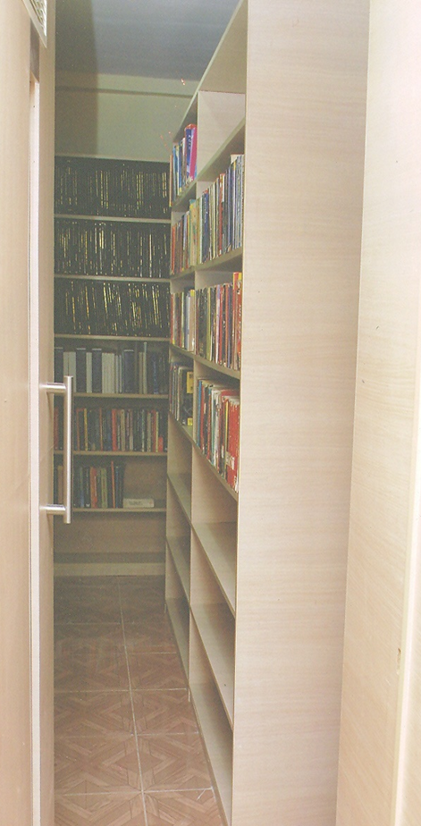
Department Library
Floor space: 87.36 Sq.mt. (Room 202).
Number of books: 500+
Number of Project (UG/PG) reports of students who have graduated: 200+
Budget of Current Financial Year for department library(CFY) 15-16 20000/-
Total 35 books are procured from Department Library for Academic Year 2015-2016
BACK

Slide 122
Faculty Details
Teaching and Support Staff

Slide 123
Profile : Faculty Details
Sr. No | Cadre | No. of Faculty | AICTE Requirement
1 | Professor | 02 | 02
2 | Associate Professor | 04 | 06
3 | Assistant Professor(incumbent 5th pay) | 01 | -
3 | Assistant Professor(6th pay) | 16 | 16
4 | Assistant Professor (Ad-Hoc) | 04 | -
5 | Pro-Term Lecturer | 01
6 | Teaching Assistants | 02 | -
Total Number of Faculty |  | 28+2 | 24
Sr. | Category | Count
1 | Total No. of Faculty Members | 28+2
2 | Faculty Members with Ph.D. | 04
3 | Faculty Members Pursuing Ph.D. | 06
4 | Faculty Members with M.E. M. Tech. | 17
6 | Teaching Assistant | 03
BACK

Slide 124
Upgradation Qualification Details
Academic Year | PhD Completed | PhD Pursuing | Post Graduates (PG) Completed | Post Graduates (PG) Pursuing | Graduates (BE)
2010-2011 (Last NBA) | 0 | 4 | 8 | 8 | 8
2014-2015 | 3 | 6 | 17 | 2 | 0
2015-2016 | 4 | 6 | 17 | 3 | 0
BACK

Slide 125
Experience Details
Category | Experience
Minimum | 1 Year 4 months
Average | 9 years 2 months
Maximum | 21 years
BACK

Slide 126
Supporting Staff
Department has 09 Supporting Staff (02 Lab Assistants + 05 Lab Attendants + 02 Teaching Assistants)
Name of Lab Assistant | Qualification | Skillset
Mr. Anil Taware | Diploma in Digital Electronics | Networking, OS Installation, MS Office
Mr. Ashish Mudholkar | BSc. Physics | Networking, OS Installation, MS Office
Name of Lab Attendant | Qualification | Skillset
Mr. Sandeep Kumar Singh | HSC, M. A. | Networking, OS Installation, MS Office
Mr. Vinodkumar Maurya | H.S.C. | Networking, OS Installation, MS Excel, Google Docs
Mr. Phaujdar Ram | H.S.C, B. C. A . (Pursuing), MSCIT, Diploma in PC Maintanance& Networking | Networking, OS Installation, MS Excel, Google Docs, Photoshop, Hardware Troubleshooting
Mr. Ganesh Nanaware | MSCIT, TY B. Com (Pursuing). | Networking, OS Installation, MS Office
Mr. Vaibhav Chavan. | Diploma in Computer Hardware & Networking, MS-CIT, B. C. A . (Pursuing) | Networking, OS Installation, MS Office, Hardware Troubleshooting
Name of Teaching Assistant | Qualification | Skillset
Ms. Yogita Ganage | BE IT, ME IT (Pursuing) | Networking, Hardware, Linux Installation
Mr. Hemant Deokar | BE IT, ME IT (Pursuing) | Networking, NS2, Matlab, Windows and Linux Installation
BACK

Slide 127
Students’ Details

Slide 128
Students’ Admission
Sr. | Item | CAY 2015-16 | CAY 2014-15 | CAYm1 2013-14 | CAYm1 2012-13 | CAYm1 2011-12
1 | Sanctioned intake strength in the institute (N) | 120 | 120 | 120 | 120 | 120
2 | Number of students admitted on merit basis (N1) (Centralized Admission 29%) | 41 | 42 | 42 | 42 | 37
3 | Number of students admitted on management quota/otherwise (N2) (Minority 51%+ Institute 20%) | 85 | 85 | 85 | 85 | 85
 | Total number of admitted students in the institute (N1 + N2)) | 126 | 127 | 127 | 127 | 122
BACK

Slide 129
Admission Details
 | 2015-2016 | 2014-2015 | 2013-14 | 2012-13 | 2011-12 | 2010-11 | 2009-10 | 2008-09 | 2007-08
Sanctioned intake strength of the programme (N) | 120 | 120 | 120 | 120 | 120 | 120 | 120 | 120 | 120
Total number of students admitted in first year minus number of students migrated to other programme at the end of 1st year (N1) | 126 (120+6) | 127 (120+1 +6) | 127 (120+1 +6) | 127 (120+1 +6) | 122 (120+0 +2) | 120 (119+1) | 120+1 | 120+1 | 120+1
Number of students admitted in 2nd year in the same batch via lateral entry (N2) | NA | 24 | 34 | 31 | 24 | 37 | 26 | 20 | 20
Total number of students admitted in the programme (N1 + N2) ** DSE Admission in Next AY | 126** | 151 | 161 | 158 | 146 | 157 | 147 | 150 | 141
BACK

Slide 130
Students Ratio
BACK

Slide 131
Admission Quality (Entry Level Marks for IT Dept.)
Rank Range | 2015-2016 | 2014-2015 | 2013-2014 | 2012-2013 | 2011-2012 | 2010-2011
More than 98 percentile | 0 | 0 | 0 | 0 | 0 | 0
95 – 98 percentile | 0 | 1 | 0 | 1 | 0 | 0
90 – 95 percentile | 15 | 10 | 0 | 0 | 0 | 0
80 – 90 percentile | 42 | 29 | 1 | 1 | 0 | 1
70-80 percentile | 10 | 19 | 8 | 9 | 3 | 19
60-70 percentile | 18 | 18 | 7 | 26 | 19 | 28
50-60 percentile | 26 | 28 | 39 | 21 | 44 | 20
Below 50% percentile | 33 | 22 | 66 | 63 | 55 | 53
Admitted Without Rank | 0 | 0 | 0 | 0 | 0 | 0
BACK

Slide 132
Student Teacher Ratio
Department has Twenty Eight (28) qualified faculty members including PG teachers and two (02) Teaching Assistants
Sanctioned intake : 144, Total Strength as per intake : 360
Faculty Required as per sanctioned intake : 360/15 = 24
Total Number of Students in IT Department :
SE : 150
TE : 147
BE : 148
Total : 445
Sr. | Students Strength | STR UG | STR Including PG Teacher
 | Without Teaching Assistant
1 | As Per Sanction Intake | 14.40 | 12.86
2 | As Per Actual Strength | 17.80 | 15.89
 | Including Teaching Assistants
3 | As Per Sanction Intake | 13.33 | 12.00
4 | As Per Actual Strength | 16.48 | 14.83
BACK
Notes:
Need To Check with CR5

Slide 133
Student-Teacher Ratio (STR)
AY | No. of students in 2nd year | No. of students in 3rd year | No. of students in 4th year | Total No. of students | Total no. of faculty members | STR | Assessment (max.=20)
(2011-12) | 144 | 144 | 144 | 432 | 30 | 14.4 | 20
(2012-13) | 144 | 144 | 144 | 432 | 29 | 14.89 | 20
(2013-14) | 144 | 144 | 144 | 432 | 28 | 15.42 | 19.45
(2014-15) | 144 | 144 | 144 | 432 | 29 | 14.89 | 20
(2015-16) | 144 | 144 | 144 | 432 | 30 | 14.4 | 20
 | Average assessment |  |  |  |  |  | 20

Slide 134
Centres for Self learning Beyond Curriculum
Sr. No. | Name of programme | Year of Inception | Objective | Outcome
1 | IIB remote centre | May 2012 | This project envisions empowerment of teachers, through workshops conducted for thousands of teachers | Enhancement in the understanding of teacher in respective course will improve the class room teaching.
3 | Robotics centre in collaboration with IITB | January 2013 | To provide platform for showcasing student/research projects . Bring together other colleges under eYantra labs for discussion and seminars on how to convert innovative ideas into product. | Students is expected to use & demonstrate a self learning ability by practical implementation of a concept pertaining robots .Students will start thinking about development of innovative approach's and an entrepreneurial mind set to problem solving.
4. | Thakur Accenture innovation centre | Jan. 2012 | To conduct training program and seminar | To provide them with competent engineering graduate with the knowledge of advanced technology
5. | R & D cell & incubation centre | August 2013 | 1.To motivate faculty members and students for research and development 2. To interact with industry, government, professionals, experts from research laboratory | To inculcate innovative and entrepreneurship skill
6 | HOC Cell | July 2015 | Higher Education and Online Certification | Higher Studies, Better Employability of the students

Slide 136
Industry Institute Interaction
Infosys : CC, Industry Electives, FEP, Conference Sponsorship .
Accenture: HSFP, Radio Jockey, Innovation Center, Conference Sponsorship .
Persistent: Symposium, Persistent TPO meet, Student BE Project, Local IV by invitation, Conference Sponsorship & invited talk, Resource person for IOW etc.
Microsoft : Microsoft Student Associate Program, MSN Academic Alliance
TCS : Resource person in SDP, Conference, IOW.
Zensar Tech Training Programs . And many more..

Slide 137
Profile : Continued…
Collaboration
Professional body – ACM -SIGITE,
ISTE
Industry Campus Connect
Infosys, Microsoft, Oracle Inc. , Accenture, Persistent, Zensar Tech. etc.
Institute Connect
IIT Bombay, IIT Kharagpur & University of Mumbai for faculty & student development program for FDP, SDP. Sessions through Remote Center (RC)
Elsevier, ACM, IJCA, IJAIS

Slide 138
Adequacy of Budget Allocation
Budget Head | Requirement 2014-15 | Expenditure 2014-15 | Requirement 2013-14 | Expenditure 2013-14 | Requirement 2012-13 | Expenditure 2012-13 | Requirement 2011-12 | Expenditure 2011-12
IT Requirement | 440000 | 358800 | 2437000 | 2348501 | 22,30,000 | 2143100 | 12,79,500 | 10,43,172
Lab Requirement | 617735 | 565487 | 10735 | 3617 | 248000 | 248000 | 2,40,000 | 72,000
Academic Requirement | 76000 | 25000 | 55000 | 25355 | 80000 | 49000 | 1,14,300 | 60,000
Infrastructure Requirement | 12000 | 2100 | 27000 | 5063 | - | - | 117075 | -
Contingencies | 20000 | - | 20000 |  | 20,000 | - | 20,000 | -
Total | 1165735 | 951387 | 2549735 | 2382536 | 2578000 | 2440100 | 1770875 | 11,75172
Utilization |  | 0.82 |  | 0.93 |  | 0.94 |  | 0.66
BACK

Slide 139
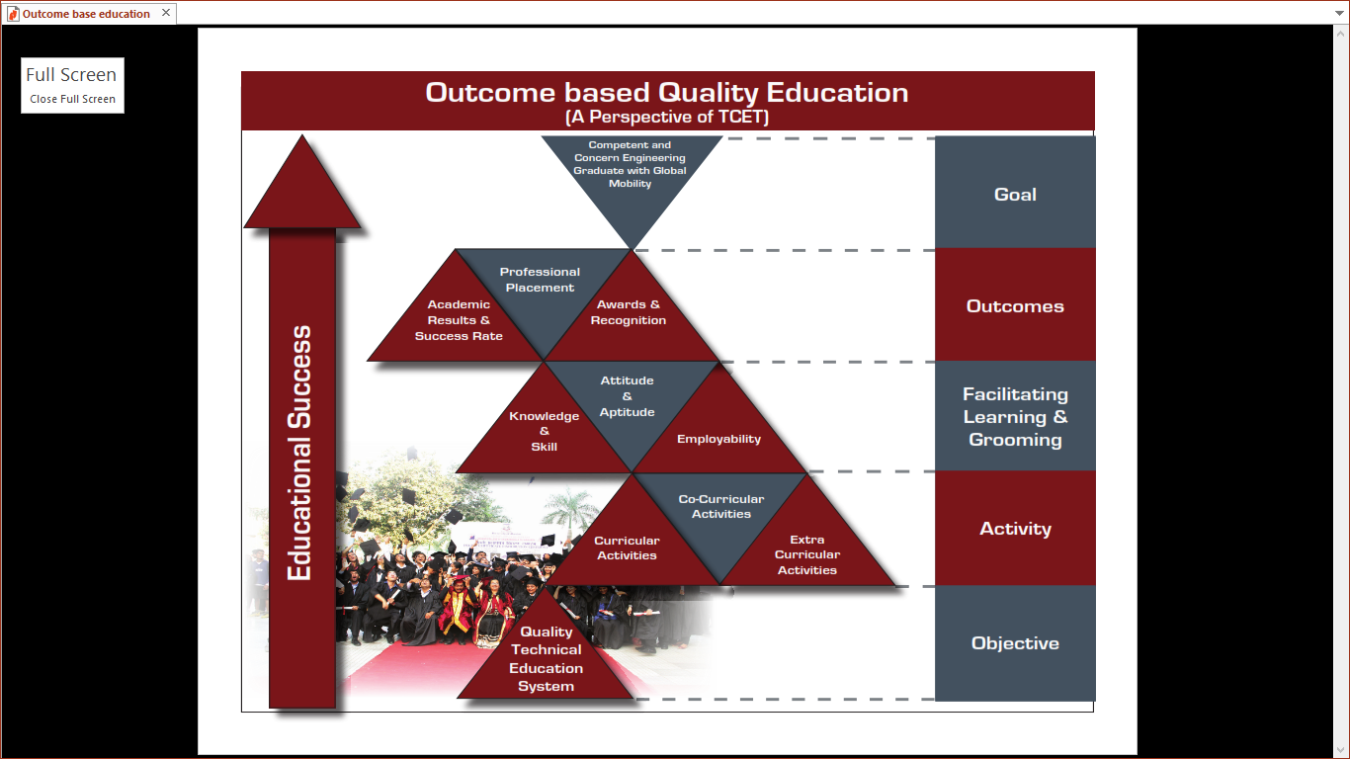
Outcome Based Quality Education – A Perspective of TCET

Slide 140
Thakur Education Group
teg
6 Campuses
16 Institutes
Over 2000 Employees
Over 40000 Students

Slide 141
About Trusts
teg
Zagdu Singh Charitable Trust
Zagdu Singh Educational Trust
Thakur Educational Trust
THAKUR COLLEGE OF ENGINEERING AND TECHNOLOGY (TCET)
Thakur Polytechnic (TPOLY)
Thakur Institute of Management Studies & Research (TIMSR)
Thakur Institute of Aviation Technology (TIAT)
Thakur School of Architecture and Planning (TSAP)

Slide 142
Final Year Project Analysis

Slide 143
Project Distribution among Domains
Sr. | Domain (For AY 2015-2016) | Project Category
 |  | Application Based | Industry Based | Research Oriented | Total No of Projects
1 | Ubiquitous Computing | 5 | -- | 1 | 55
2 | Digital Signal Image Processing, Soft Computing & AI | 8 | -- | 3
3 | Database Technologies | 14 | -- | 3
4 | Web Technology and E-commerce | 12 | -- | 1
5 | Information and Communication Technology | 3 | -- | 5
 |  | 42 | -- | 13
Academic Year | Domain
 | DCN | DBMS | DSP | OS | SE | Total
2010-11 | 20 | 3 | 15 | 1 | 12 | 51
2011-12 | 15 | 8 | 11 | 1 | 14 | 49
2012-13 | 7 | 19 | 5 | 5 | 14 | 50
2013-14 | 10 | 17 | 4 | 6 | 15 | 52
2014-15 | 7 | 14 | 4 | 6 | 22 | 53
 | 59 | 61 | 39 | 19 | 77 | 255

Slide 144
Student Outhouse Project Data
Academic Year | 2016 Batch | 2015 batch | 2014 batch | 2013 batch | 2012 Batch
Number of students who were sent for Outhouse Project | In Progress | 01 | 08 | 09 | 06
Companies | In Progress | BSNL Dehradun | Deltecs Infotech Pvt. Ltd., Brandeneu Consulting Pvt. Ltd., Maxx Mobile Pvt. Ltd. | TIFR Computer Center, Persistent Systems | Neebal Technologies, NEC India Pvt.,

Slide 145
Final Year Project Analysis
Academic Year | Project Type |  |  | Student Marks
 | Application | Industry | Research | 100-90 | 81-90 | 70-80 | <70
2010-11 | 26 | 1 | 24 | 9 | 34 | 8 | 0
2011-12 | 28 | 2 | 17 | 18 | 18 | 11 | 0
2012-13 | 24 | 3 | 20 | 16 | 25 | 5 | 0
2013-14 | 31 | 3 | 14 | 23 | 12 | 5 | 5
2014-15 | 33 | 0 | 21 | 10 | 27 | 11 | 6
2015-16 | 43 | 0 | 12
Category | Outcome
Application based | Product development
Research based | Research papers Publication
Industry oriented | Knowledge transfer

Slide 146
PO Mapping to all Projects

Slide 147
Project competitions
Mini Project competition ( Department level)
  Webzine –project competition is conducted for Second Year students
  MiddleTech – Third Year Students
  BE Project competition (Department level)
    Department conducts competition of all BE project groups under ACM chapter
    Best 10 projects are selected at department level
  Project Competitions by R&D cell ( Institute level )-Mind’s Eye
    R&D cell conducts competition among 10 best selected projects at institute levels.

Slide 148
Mentoring and Department Level
TG Effectiveness

Slide 149
Mentoring system to help at individual levels
A Teacher Guardian book is maintained for each student where details like
  Students details
  Academic Record metric level onward
  Academic Performance
  Event participation
  Publication
  Membership of professional bodies
  Competitive Examination Details
  Counselling details : for all applicable reasons pertaining to students academic progress
  Co-Curricular and Extra-Curricular activities.

Slide 150
Classification of Students as per their Academic Performance
Roll No. | Name | A.Y 2012-13(SE) | A.Y 2013-14(TE) | A.Y 2014-15(BE) | Company in which placed | Achievement /award
1 | SwapnaliPadwal | A | A | A
3 | Jyoti Bansal | A | A | AA | INFOSYS
4 | Alpesh Bapna | A | A | A
5 | Sejal Bhagwat | A | A | A
6 | Drishti Bhati | A | AA | AA | ACCENTURE
7 | Nikita Deepak | A | BA | A
8 | Vinodkumar Nemaram | A | A | A
9 | Shashikant Chauhan | A | A | A
10 | Sushil Chaurasia | A | A | A | INFOSYS
11 | Sneha Chendvankar | A | A | AA
12 | Vinay Chaudhari | A | A | A | INFOSYS
13 | Jay Darji | A | A | AA | INFOSYS
14 | Siddhesh Dhotre | A | BA | A | INFOSYS
15 | Dwivedi Saranjh | BA | A | A | L&T
16 | Akshay Anbhawane | BA | AA | AA | ACCENTURE
17 | Prathamesh Gawade | A | AA | A | ACCENTURE
18 | Jinal Mehta | A | A | AA | INFOSYS
20 | Abhijeet Gupta | A | A | BA
21 | Dheeraj Gupta | A | A | A | IGATE

Slide 151
Name of the student : Ms. Swapnali Padwal Class : BEIT-A Academic Year : 2011-12 to 2014-15
FE
 | Sem-I | Sem-II
Attendance | 63.4 | 70
TT-I | 49.6 | 46
TT-II | 54 | 51
University Result | 59 | 52
AT/KT | 2
SE
 | III | IV
Attendance | 75 | 82
TT-I | 55 | 69.3
TT-II | 53.3 | 59.3
University Result | 65.8 | 67.05
AT/KT | 0
TE
 | V | VI
Attendance | 84.6 | 89
TT-I | 80.3 | 83.3
TT-II | 64.3 | 76
University Result | 75 | 75.2
AT/KT | 0
BE
 | VII | VIII
Attendance | 80.3 | 84
TT-I | 76.8 | 71
TT-II | 72.8 | 72.5
University Result | 70 | 72
AT/KT | 0

Slide 152
Progress form FE to BE

Slide 153
The OBE Framework
INSTITUTION
OUTCOMES
ASSESSMENT
EVALUATION
IMPROVEMENTS
Mission/Vision
EGA
Institutional Assessment
Industry and professional orgs
INPUTS & FEEDBACK
PEO
PROGRAM
Program
Assessment
Student Outcomes
Course Planning and Delivery
Syllabus
Teaching Methods
Learning Activities
Assessment Tools
COURSE
Courses Learning Outcomes
Course
Assessment

Slide 154
Results

Slide 156
SE Results
Examination | Distinction | First Class
May 2015 | 35.82% | 34.32%
May 2014 | 39.24% | 29.11%
May 2013 | 18.60% | 52.71%

Slide 157
TE Results
Examination | Distinction | First Class
May 2015 | 37.26% | 49.68%
May 2014 | 21.53% | 61.81%
May 2013 | 46.04% | 41.01%

Slide 158
BE Results
Examination | Distinction | First Class
May 2015 | 29.11% | 51.90%
May 2014 | 48.18% | 41.61%
May 2013 | 44.18% | 38.61%
Examination | TCET Results | University Results
May 2015 | 96.93% | 96.12%
May 2014 | 95.14% | 96.25%
May 2013 | 99.31% | 96.97%

Slide 160
Institute, Department and University Results

Slide 161
Final Year Project Analysis
Academic Year | Project Type |  |  | Student Marks
 | Application | Industry | Research | 100-90 | 81-90 | 70-80 | <70
2010-11 | 26 | 1 | 24 | 9 | 34 | 8 | 0
2011-12 | 28 | 2 | 17 | 18 | 18 | 11 | 0
2012-13 | 24 | 3 | 20 | 16 | 25 | 5 | 0
2013-14 | 31 | 3 | 14 | 23 | 12 | 5 | 5
2014-15 | 33 | 0 | 21 | 10 | 27 | 11 | 6
2015-16 | 43 | 0 | 12
Category | Outcome
Application based | Product development
Research based | Research papers Publication
Industry oriented | Knowledge transfer

Slide 162
Innovative Practices

Slide 163
Innovative Practices
Zero Cost Budgeting for ACM , TCET Activities
  .NET Workshop
  Business Continuity Planning (BCP) Seminar
  E-Zine Publication
  Industrial Visit (03 Jan to 11 Jan)
  International Conference
Cloud Based Storage and Virtualized Lab
Microsoft Students Associate Program, MS Massively Empowered Classrooms Program

Slide 164
Mapping of the of the course delivery methods to the POs
Content delivery Methods | Program out comes |  |  |  |  |  |  |  |  |  |  |  | Percentage of POs being contributed to by Content delivery methods
 | 1 | 2 | 3 | 4 | 5 | 6 | 7 | 8 | 9 | 10 | 11 | 12
M1 | ✓ |  |  |  |  |  | ✓ |  | ✓ | ✓ |  |  | 33.33
M2 | ✓ |  |  |  |  | ✓ |  | ✓ |  |  |  | ✓ | 33.33
M3 |  | ✓ | ✓ | ✓ | ✓ | ✓ |  |  |  |  |  | ✓ | 50.00
M4 | ✓ | ✓ | ✓ | ✓ |  | ✓ | ✓ | ✓ | ✓ | ✓ | ✓ | ✓ | 91.66
M5 |  | ✓ |  |  | ✓ |  |  |  | ✓ | ✓ |  | ✓ | 41.66
M6 | ✓ | ✓ | ✓ | ✓ | ✓ |  |  |  |  |  |  | ✓ | 50.00
M7 | ✓ | ✓ | ✓ | ✓ | ✓ |  | ✓ | ✓ | ✓ |  | ✓ |  | 75.00
Percentage of Course delivery methods contributing to PO | 71.4 | 71.4 | 57.14 | 57.14 | 57.14 | 42.85 | 42.85 | 42.85 | 57.14 | 42.85 | 28.57 | 71.4

Slide 166
































Major Recruiters (More then 90..)

Slide 167
PEO Achievement Summary

